Slide 1
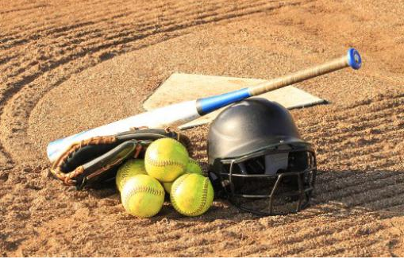
Tyler Lonestar Chapter
January 10, 2024
Coaches Meeting

Slide 2
Meeting Agenda
-Welcome
-Introductions (All)
-Rule Changes and POE’s
-Questions
-Closing Remarks

Slide 3
Welcome
Welcome Coaches to this informational meeting for the 2024 Softball Season.

Slide 4
Rules Changes
1-8-6: Permits electronic information to be transmitted to the dugout from anywhere outside of live ball area.
Rationale: The rule change reflects current technology and still requires that electronic devices used for coaching purposes may only be used in the dugout but does not stipulate where the video is recorded or how it is transmitted.
Rule 1-8-6

Slide 5
Rules Changes
3-2-3: Beginning January 1, 2027, uniforms may only bear a single manufacturer's logo, school name, school logo, mascot and/or the participant's name. Advertisements, messages, team slogans, etc., will no longer be permitted.
Rationale: Consistent language has been established for NFHS sports that describe what information is permitted on the uniform. A player’s name, school name, school nickname, school mascot and/or the school logo may be placed on the uniform.
Rule 3-2-3

Slide 6
Rules Changes
3-2-5: Removes the color restriction for headbands and ribbons.
Rationale: Adds consistency amongst headwear requirements for other NFHS sports.
Rule 3-2-5

Slide 7
Rules Changes
3-2-7: Defines where a wristband with a playbook/play card may be worn. If worn by the pitcher, the wristband with a playbook/play card must be worn on the non-pitching wrist or arm.
Rationale: Clarifies where this equipment can be worn. This change will prohibit wristbands from being worn on the belt. It remains legal for players to keep the wristband with a playbook/play card in their back pocket.
Rule 3-2-7

Slide 8
Rules Changes
4-2-7, 10-2-3e, h: The umpire may call (end) a game if playing conditions in or around the facility become unacceptable to safely continue the game.
Rationale: Provides rule justification when an umpire ends a contest due to unacceptable playing conditions to continue play in addition to weather.
Rule 4-2-7, 10-2-3e, h

Slide 9
Rules Changes
6-1-2c, 2-47: The pitcher may now have both feet off the ground at the same time as long as both feet remain within the 24-inch width of the pitching plate and the pitcher does not replant the pivot foot. A definition for a replant was added.
Rationale: The rule change permits both feet to disengage from the playing surface while delivering a pitch. The addition of Rule 2-47 defines that a replant of the pivot foot occurs when the pitcher pushes off the playing surface from anywhere other than the pitcher’s plate prior to the act of delivering the pitch.
Rule 6-1-2c, 2-47

Slide 10
Rules Changes
6-2-2: Pitchers can only use dirt, powdered rosin or comparable drying agents that are listed on the USA Softball’s certified equipment webpage to dry the hand.
Rationale: Clarifies the difference between tape and other non-approved substances on the pitching hand or fingers versus the use of approved substances under the supervision and control of the umpire.
Rule 6-2-2

Slide 11
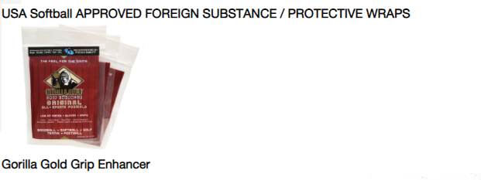
Rules Changes
6-2-2
Comparable Drying Agents

Slide 12
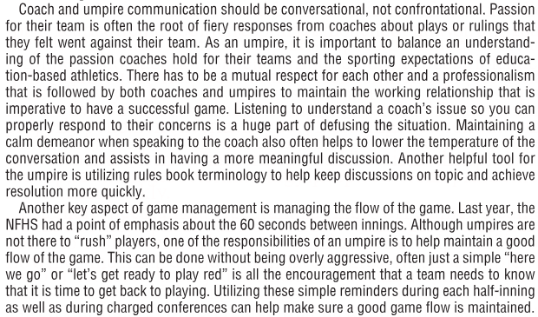
Points of Emphasis
Game Management

Slide 13
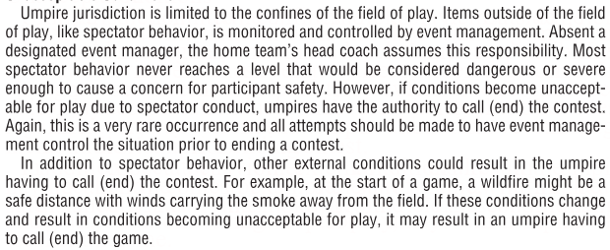
Points of Emphasis
Unacceptable Conditions

Slide 14
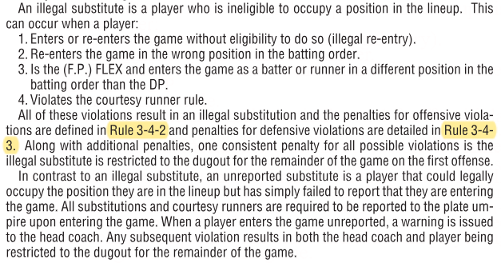
Points of Emphasis
Unreported v. Illegal Substitutions

Slide 15
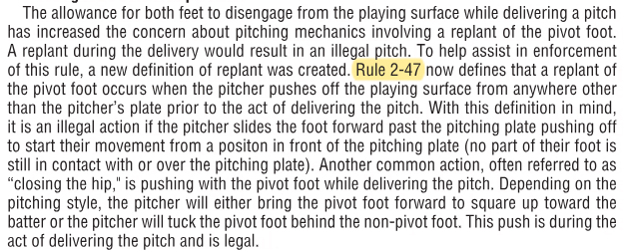
Points of Emphasis
Pitching Mechanics: Replant

Slide 16
Closing
Points of Contact
Oscar Strain
903-885-0502
President
Tom Cremeans
903-286-2080
VP & UIC, Rules Questions
Chuck Allen
214-356-4770
Assigner

Slide 17
Questions

