Slide 1
Tyler Lonestar Chapter
2022
Rules & POE
January 16, 2022
General Meeting

Slide 2
2022 NFHS SOFTBALL RULES RULE’S CHANGES/CLARIFICATION

Slide 3
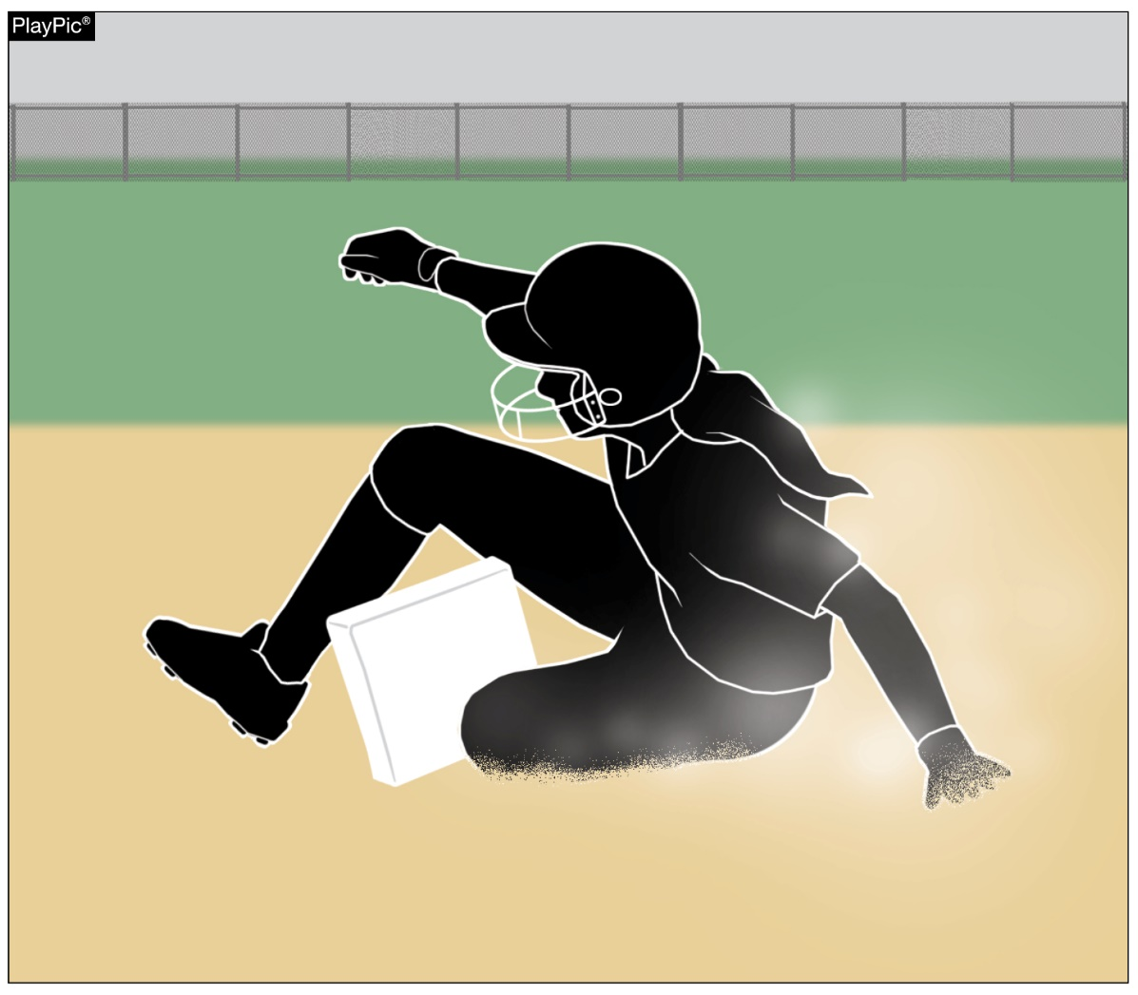
BASES, PLATES RULE 1-2-1
Bases may be designed to disengage from their anchor system.
Notes:
Rule 1-2-1: Bases may be designed to disengage from their anchor system.
Rationale: Language was added to clarify that break away bases are permitted. Rule 8-8-14 EFFECT states a runner reaching a base safely will not be out for being off the base if it becomes dislodged. The NFHS interpretation has been that breakaway bases are permitted. The suggested change formalizes this interpretation and places it with other regulations covering the field and its equipment.

Slide 4
BASES, PLATES RULE 1-2-1
Reason for the change
Only one, and it’s a big one – SAFETY
Reality
Schools have been using breakaway based for years
Change legitimizes current practice
Implementation
Nothing changes
Runners cannot be called out if the base is dislodged, the base is considered to have followed the runner
Notes:
Rule 1-2-1: Bases may be designed to disengage from their anchor system.
Rationale: Language was added to clarify that break away bases are permitted. Rule 8-8-14 EFFECT states a runner reaching a base safely will not be out for being off the base if it becomes dislodged. The NFHS interpretation has been that breakaway bases are permitted. The suggested change formalizes this interpretation and places it with other regulations covering the field and its equipment.

Slide 5
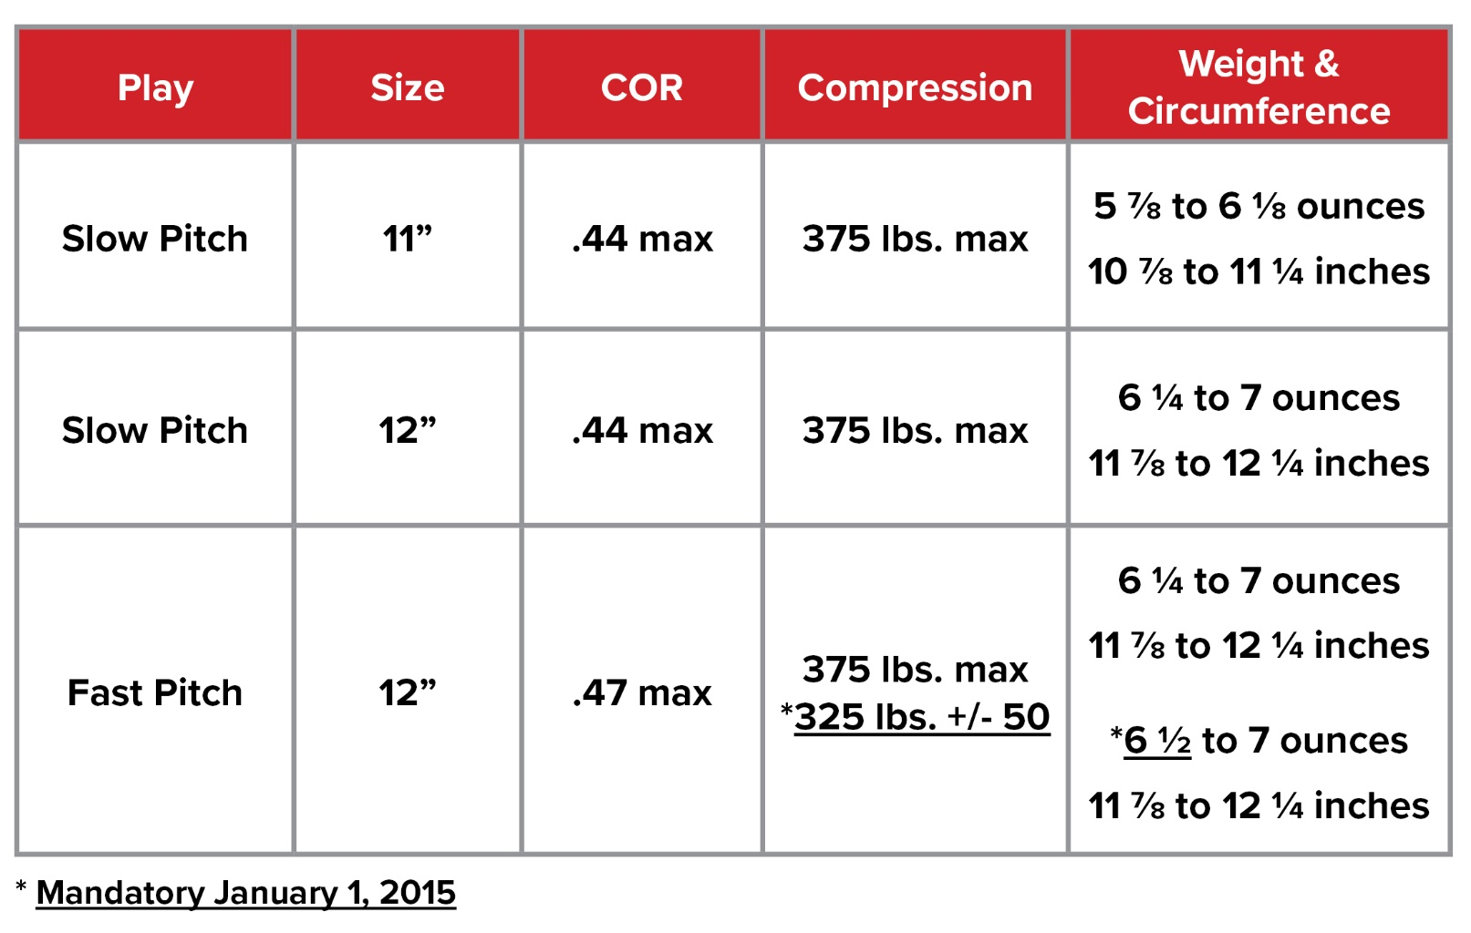
SOFTBALLS RULE 1-3-3
The new ball specifications are permissible currently and will be required January 1, 2025, for high school competition.
Balls manufactured with the current specifications will be permitted for use through 2024.
*Mandatory January 1, 2025
Notes:
Rule 1-3-3
The new ball specifications are permissible currently and will be required January 1, 2025, for high school competition.
Balls manufactured with the current specifications will be permitted for use through 2024.
Rationale: Ball tolerance specifications for the 12-inch Fast Pitch Softball have been standardized for NFHS, NCAA, and USA Softball. After conducting research on whether the minimal changes might have an impact on safety, it was determined that changing the weight from 6¼ to 6½ ounces would not increase batted ball speed. Any balls manufactured with the former specifications will be permitted through 2024, to allow for state associations manufacturers to reduce current inventory. The new ball specifications are permitted for use during the 2021-22 season and will be required by January 1, 2025.

Slide 6
SOFTBALLS RULE 1-3-3
What changed?
Compression can range from 275 to 375 lbs.
Some balls will not be a “hot” as balls are today
Weight increases by ¼ lb.
Make sure to bring you scale to the field with you!
Why?
For consistency with other codes
Manufacturing efficiencies – some balls are dual certified
Notes:
Rule 1-3-3
The new ball specifications are permissible currently and will be required January 1, 2025, for high school competition.
Balls manufactured with the current specifications will be permitted for use through 2024.
Rationale: Ball tolerance specifications for the 12-inch Fast Pitch Softball have been standardized for NFHS, NCAA, and USA Softball. After conducting research on whether the minimal changes might have an impact on safety, it was determined that changing the weight from 6¼ to 6½ ounces would not increase batted ball speed. Any balls manufactured with the former specifications will be permitted through 2024, to allow for state associations manufacturers to reduce current inventory. The new ball specifications are permitted for use during the 2021-22 season and will be required by January 1, 2025.

Slide 7
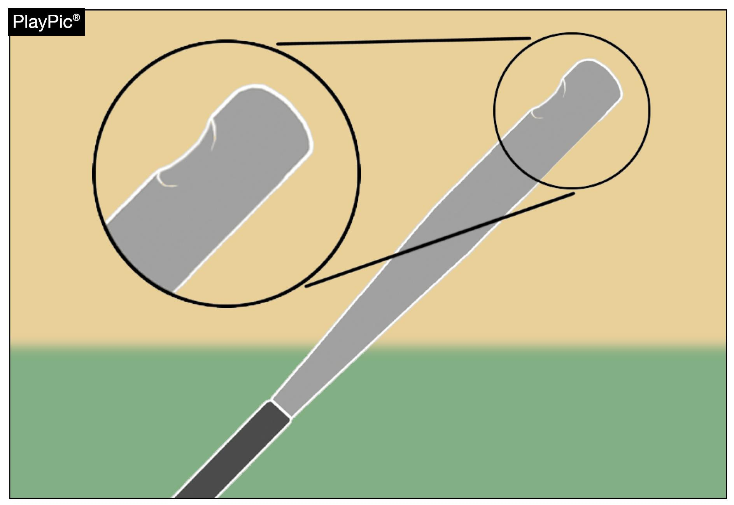
DAMAGED BAT RULE 2-4-3
A damaged bat is one that could deface the ball and the bat shall be removed when initially detected without penalty.
Also, a penalty was added for a batter detected using a damaged bat after it has been previously removed from the game.
Notes:
Rule 2-4-3: A damaged bat is one that could deface the ball and the bat shall be removed when initially detected without penalty. Also, a penalty was added for a batter detected using a damaged bat after it has been previously removed from the game.
Rationale: The addition of Rule 3-6-21, which defines the penalty for re-introducing a previously removed damaged bat to the game, necessitated adding language to the definition of a damaged bat in Rule 2-4-3.

Slide 8
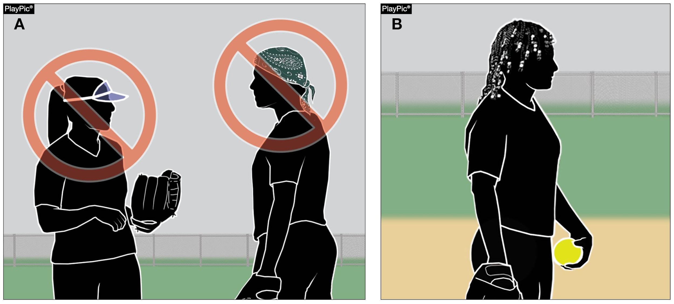
UNIFORMS, PLAYER EQUIPMENT RULE 3-2-5b, 3-2-12
Plastic visors and bandannas are still prohibited. However, language prohibiting hard items to control the hair, such as beads, has been removed.
Notes:
Rule 3-2-5b, 3-2-12 – Language prohibiting hard items to control the hair, such as beads, has been removed. However, plastic visors and bandannas are still prohibited.
Rationale: This change removes the language prohibiting hard items to control the hair and aligns language with other NFHS rules codes. Language was also removed in Rule 3-2-12 that prohibited players from wearing hard cosmetic or decorative items.

Slide 9
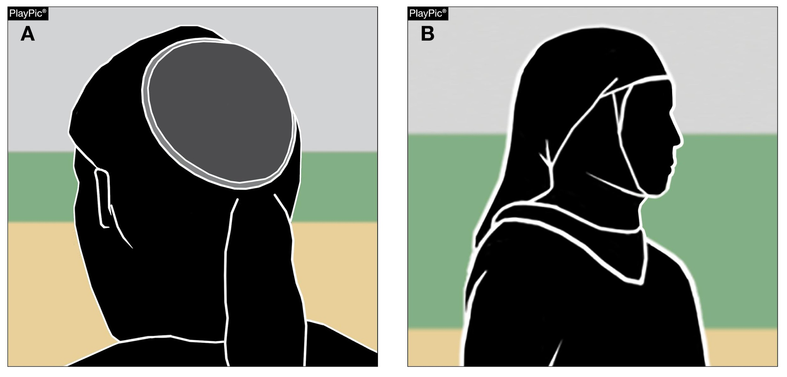
UNIFORMS, PLAYER EQUIPMENT RULE 3-2-5c
Players may wear head coverings for religious reasons. The headwear must be made of non-abrasive, soft materials and must fit securely so that it is unlikely to come off during play. Head coverings worn for medical reasons must still receive state association approval.
Notes:
Rule 3-2-5c: Players may wear head coverings for religious reasons. The headwear must be made of non-abrasive, soft materials and must fit securely so that it is unlikely to come off during play. Head coverings worn for medical reasons must still receive state association approval.
Rationale: This rule change eliminates the need for authorization from the state association for religious headwear while maintaining the requirement for approval of head coverings worn for medical reasons. The State Association shall be notified after the contest if there is a concern as to whether the head covering was worn for religious reasons.

Slide 10
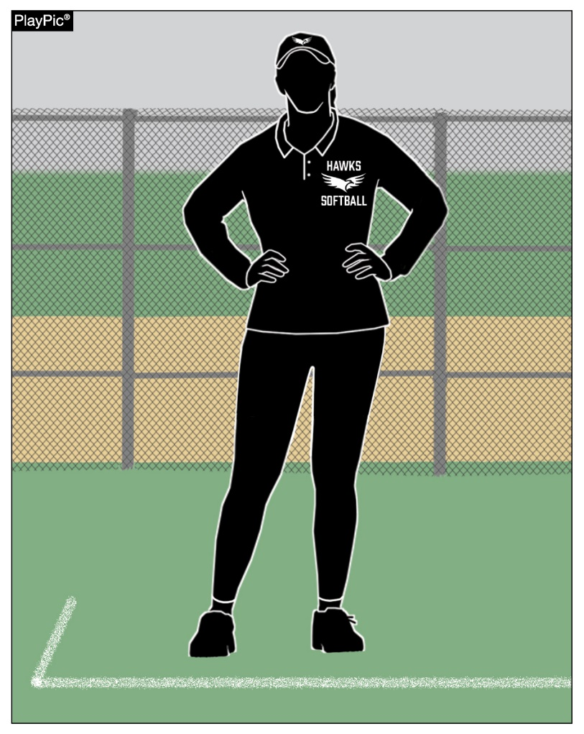
COACH ATTIRE RULE 3-5-3
While in live-ball areas, a coach shall be attired in a school uniform or jersey/coaching shirt with slacks, shorts, or other leg coverings in school colors or colors of khaki, black, white or gray.
Notes:
Rule 3-5-3: While in live-ball areas, a coach shall be attired in a school uniform or jersey/coaching shirt with slacks, shorts, or other leg coverings in school colors or colors of khaki, black, white or gray.
Rationale: Edits for grammatical purposes. Additional language brings a coach’s attire up to date with current language used to describe a coaching garment. Reports have been submitted indicating that some female coaches were disqualified from coaching a contest due to being attired in apparel not specifically listed in the current rule. New language better defines permissible coach’s attire.

Slide 11
COACH ATTIRE RULE 3-5-3
Coaches can wear any style of leg covering
Stretch pants – ok
Jeans – Not ok
If color worn is not permissible:
Ask for them to change
Yes, play on
No, play on, submit UIL incident report via TASO web site after the game
Notes:
Rule 3-5-3: While in live-ball areas, a coach shall be attired in a school uniform or jersey/coaching shirt with slacks, shorts, or other leg coverings in school colors or colors of khaki, black, white or gray.
Rationale: Edits for grammatical purposes. Additional language brings a coach’s attire up to date with current language used to describe a coaching garment. Reports have been submitted indicating that some female coaches were disqualified from coaching a contest due to being attired in apparel not specifically listed in the current rule. New language better defines permissible coach’s attire.

Slide 12
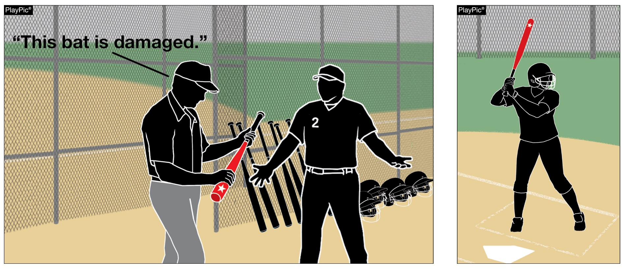
BENCH AND FIELD CONDUCT RULE 3-6-21,PENALTY (NEW)
Batters shall not use a damaged bat that was previously removed from the game by an umpire. PENALTY: The batter shall be called out and the batter and head coach shall be restricted to the dugout for the remainder of the game.
Notes:
Rule 3-6-21 and PENALTY: Batters shall not use a damaged bat that was previously removed from the game by an umpire. PENALTY: The offender shall be called out and the offender and head coach shall be restricted to the dugout for the remainder of the game.
Rationale: This new article clarifies that a damaged bat, which had been previously removed by an umpire, cannot be reintroduced to the game. It also adds a penalty, which states that the batter is out and both the player and the head coach are restricted to the dugout.
For clarification, a damaged bat is defined as a bat that was once legal and subsequently found to have cracks, rattles, dents or burrs; an illegal bat is defined as a bat that has been altered or does not meet the required specifications of a legal bat has been altered or is non-approved (Rule 7-4-2). The first offense for bringing a damaged bat into the batter’s box is the removal of the damaged equipment from the contest without further penalty. A second offense for bringing a damaged into the batter’s box or is discovered having used a damaged bat a second time will result in the batter being called out, and the head coach and the offender will be restricted to the dugout for the remainder of the contest, and all runners not put out on the play must return to the base occupied at the time of the pitch.

Slide 13
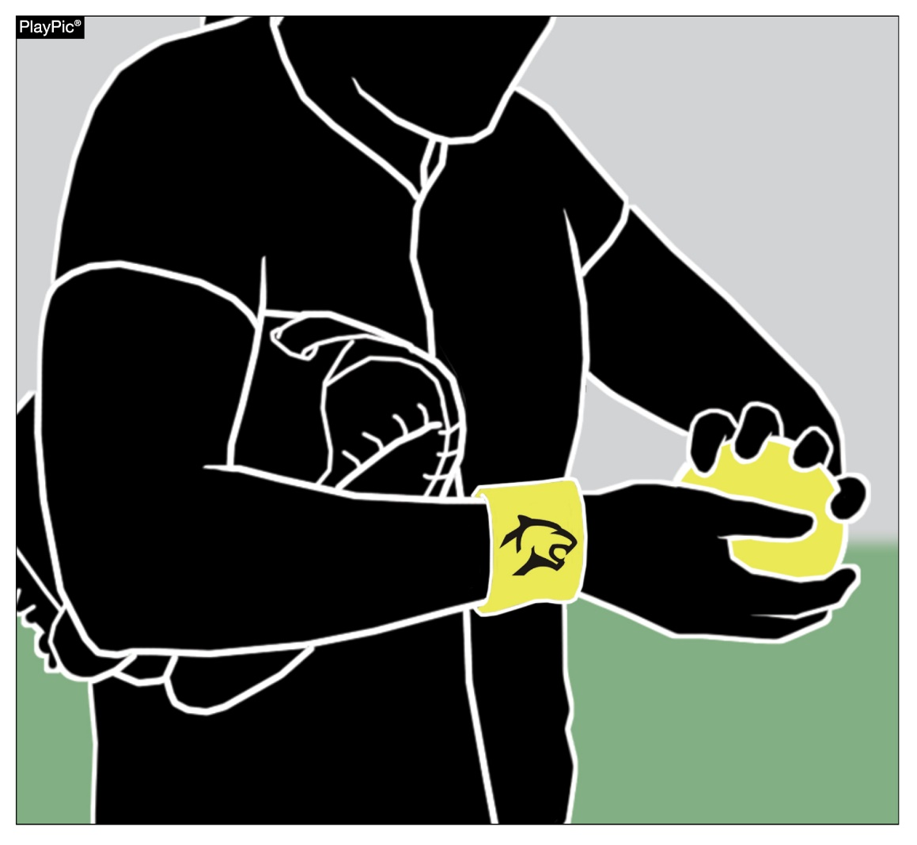
INFRACTIONS BY PITCHER (FP) RULE 6-2-2 & NOTE (NEW)
Pitchers are prohibited from wearing anything on the pitching hand, wrist, arm or thighs which the umpire judges to be distracting to the batter.
This language has been moved out of the penalty for 6-2-2 and a new note was created to clarify distracting items fall under equipment and are not subject to an illegal pitch penalty.
Notes:
Rule 6-2-2 & NOTE - Pitchers are prohibited from wearing anything on the pitching hand, wrist, arm or thighs which the umpire judges to be distracting to the batter.
This language has been moved out of the penalty for 6-2-2 and a new note was created to clarify distracting items fall under equipment and are not subject to an illegal pitch penalty.
Rationale: The pitcher having an item on the pitching hand, wrist, arm or thigh is a violation of the equipment rule and is already addressed in 3-2-9 with a penalty. Having it as a part of 6-2-2 invokes a different penalty than prescribed by Rule 3-2-9. Making it a note in this section still provides the support to keep pitchers legal in this section but removes the discrepancy in penalties.

Slide 14
INFRACTIONS BY PITCHER (FP) RULE 6-2-2 & NOTE (NEW)
What distracts you as an official?
What would you do if a coach or player brought it to your attention?
Notes:
Rule 6-2-2 & NOTE - Pitchers are prohibited from wearing anything on the pitching hand, wrist, arm or thighs which the umpire judges to be distracting to the batter.
This language has been moved out of the penalty for 6-2-2 and a new note was created to clarify distracting items fall under equipment and are not subject to an illegal pitch penalty.
Rationale: The pitcher having an item on the pitching hand, wrist, arm or thigh is a violation of the equipment rule and is already addressed in 3-2-9 with a penalty. Having it as a part of 6-2-2 invokes a different penalty than prescribed by Rule 3-2-9. Making it a note in this section still provides the support to keep pitchers legal in this section but removes the discrepancy in penalties.

Slide 15
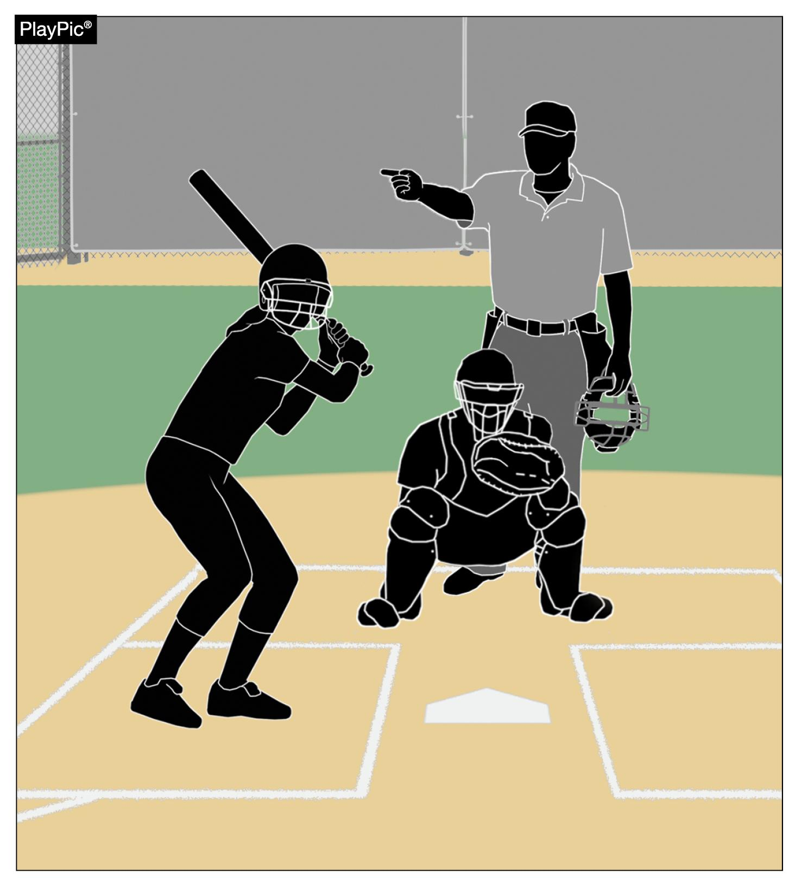
DAMAGED BAT RULE 7-4-15, PENALTY (NEW)
Adds language to identify a batter entering the batter’s box with a damaged bat previously removed from the game is out.
Notes:
Rule 7-4-15 (NEW): Adds language to identify a batter entering the batter’s box with a damaged bat previously removed from the game is out.
Rationale: The addition of Rule 3-6-21, which defines the penalty for re-introducing a previously removed damaged bat to the game, necessitated adding new Rule 7-4-15 defining situations when the batter is out.

Slide 16
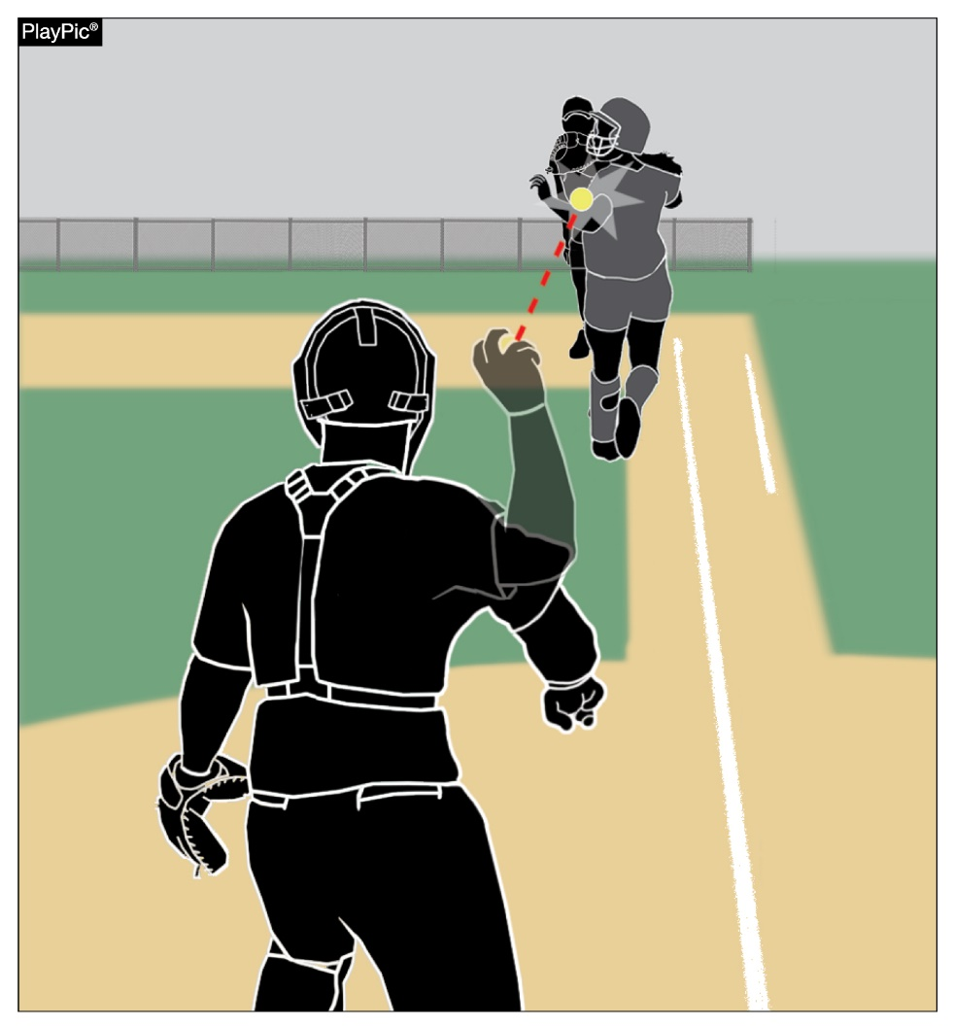
BATTER-RUNNER IS OUT RULE 8-2-6
A runner is considered outside the running lane if either foot last contacted the ground completely outside the lane.
Notes:
Rule 8-2-6: A runner is considered outside the running lane if either foot last contacted the ground completely outside the lane.
Rationale: The change clarifies a batter-runner’s location in relationship to the running lane when either foot is in the air. The batter-runner is considered to be outside of the running lane if either foot last contacted the ground completely outside the running lane.
There has been some confusion about how this rule should be officiated. Some umpires base their ruling on whether the runner’s foot is on the ground or in the air at the time of the interference. For example, the runner is not guilty of interference if they lift their foot right before being hit with the ball but are guilty of interference if the ball hits them while their foot is in contact with the ground. The intent of this rule is to ensure the batter-runner runs in the running lane. This new wording more adequately describes the intent of the rule and will provide more consistent enforcement.

Slide 17
BATTER-RUNNER IS OUT RULE 8-2-6
Past rule stated “if either foot is completely outside the lane and in contact with the ground”
How will you call this?
Notes:
Rule 8-2-6: A runner is considered outside the running lane if either foot last contacted the ground completely outside the lane.
Rationale: The change clarifies a batter-runner’s location in relationship to the running lane when either foot is in the air. The batter-runner is considered to be outside of the running lane if either foot last contacted the ground completely outside the running lane.
There has been some confusion about how this rule should be officiated. Some umpires base their ruling on whether the runner’s foot is on the ground or in the air at the time of the interference. For example, the runner is not guilty of interference if they lift their foot right before being hit with the ball but are guilty of interference if the ball hits them while their foot is in contact with the ground. The intent of this rule is to ensure the batter-runner runs in the running lane. This new wording more adequately describes the intent of the rule and will provide more consistent enforcement.

Slide 18
2022 NFHS SOFTBALL RULES MAJOR EDITORIAL CHANGES

Slide 19
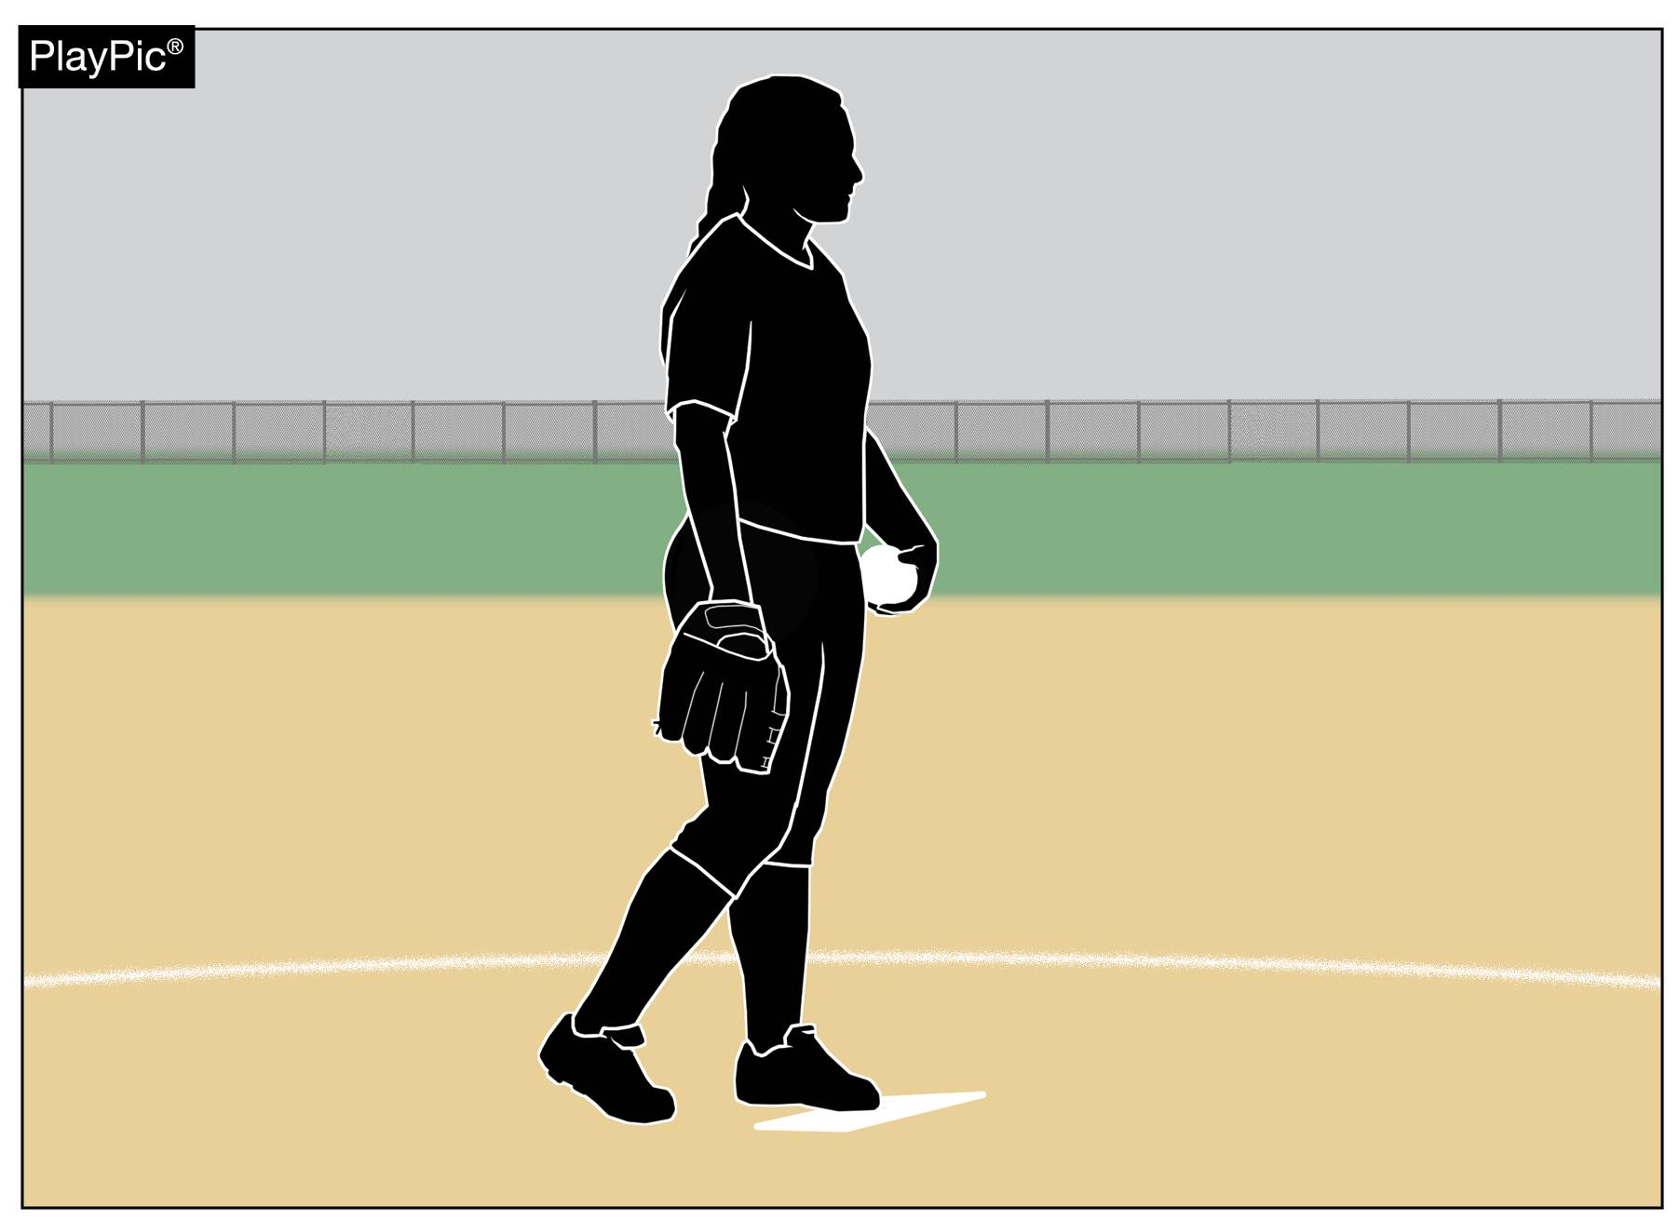
PITCHER RULE 2-44
The pitcher is the player who is designated in the scorebook as being responsible for delivering (pitching) the ball to the batter.
Notes:
Rule 2-44: The pitcher is the player who is designated in the scorebook as being responsible for delivering (pitching) the ball to the batter.
Rationale: Because defensive changes, including to the pitcher, are not required to be reported the pitcher may not be designated in the scorebook. This clarification will match this rule to 2-10-1 (catcher definition) and will eliminate potential conflict/confusion with 8-9-2 which defines for whom a courtesy runner may be used.

Slide 20
PITCHER RULE 2-44
Do we ever see a scorebook?
No, we see the line up card
Notes:
Rule 2-44: The pitcher is the player who is designated in the scorebook as being responsible for delivering (pitching) the ball to the batter.
Rationale: Because defensive changes, including to the pitcher, are not required to be reported the pitcher may not be designated in the scorebook. This clarification will match this rule to 2-10-1 (catcher definition) and will eliminate potential conflict/confusion with 8-9-2 which defines for whom a courtesy runner may be used.

Slide 21
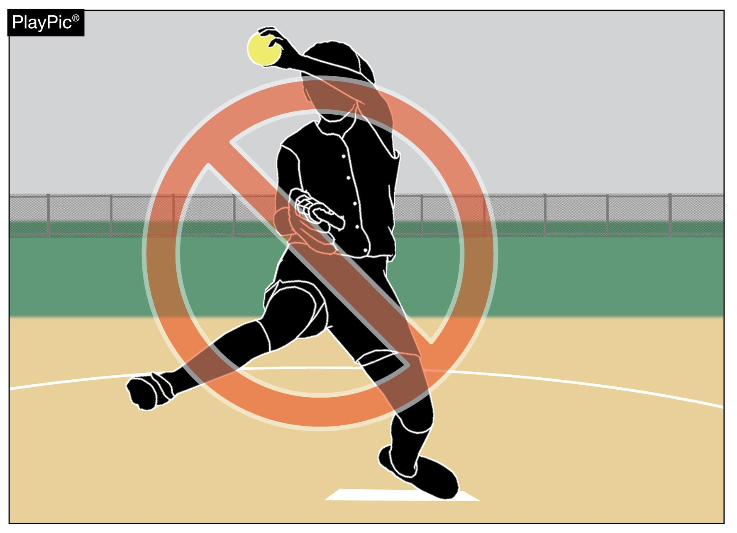
WARM-UP PITCHES RULE 3-7-1 NOTE
Clarifies no warm-up pitches are permitted if a pitcher is removed and then returns to the pitching circle in the same half-inning.
Notes:
Rule 3-7-1 NOTE: Clarifies no warm-up pitches are permitted if a pitcher is removed and then returns to the pitching circle in the same half-inning.

Slide 22
WARM-UP PITCHES RULE 3-7-1 NOTE
Aligns with other softball organizations
Speeds up the game
Notes:
Rule 3-7-1 NOTE: Clarifies no warm-up pitches are permitted if a pitcher is removed and then returns to the pitching circle in the same half-inning.

Slide 23
DEAD BALL RULE 5-1
TABLE 5-1 BALL DEAD IMMEDIATELY
Activity | References | Awards or Penalties | References
12. Fair ball touches a spectator. | 5-1-1f | Award all runners appropriate number of bases in umpire's judgement. | 8-4-3j
13. Fair ball bounces over, through or lodges in fence. | 5-1-1f | Award all runners two bases. | 8-4-3g
Table 5-1 previously combined two different rules with two completely different penalties/awards. The change separates the two rules and penalties/awards.
The remaining rule references were renumbered.
Makes the dead ball tables much easier to use
Notes:
Rule 5-1 Dead Ball Table: Table 5-1 previously combined two different rules with two completely different penalties/awards. The change separates the two rules and penalties/awards. The remaining rule references were renumbered.

Slide 24
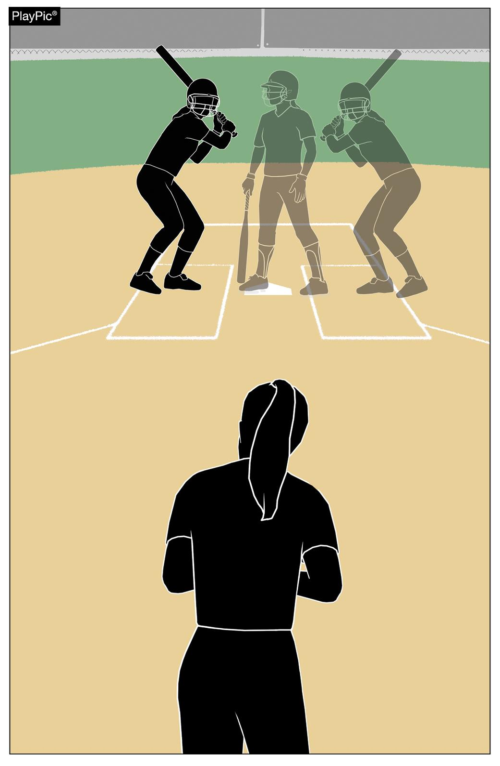
BATTER’S BOX RESTRICTIONS RULE 7-3-1
A batter may not step out of the batter’s box when the pitcher is in contact with the pitcher’s plate.
Notes:
Rule 7-3-1: A batter may not step out of the batter’s box when the pitcher is in contact with the pitcher’s plate.
Rationale: Aligns language with a rule change from the previous year.

Slide 25
2022 NFHS SOFTBALL RULES POINTS OF EMPHASIS

Slide 26
HUDDLES BETWEEN INNINGS
Participant safety is always a priority.
There is no perfectly safe place to huddle unless it is in a fully fenced dugout.
Remind coaches during pre-game meeting that they need to ensure their players are not in the line of possible warm-up overthrows, and that behind the fence is safer than on the field.
Notes:
HUDDLES BETWEEN INNINGS
If a team chooses to huddle on the field after a third out while the other team is warming up, care should be taken to ensure they do so in a safe location. In between innings as the defensive team takes the field and begins to throw the ball, the offensive team should only huddle in an area that does not impede the warm-up of the defensive team nor places them in areas where overthrows are likely. Huddling should be limited to the amount of time needed for the defensive players to make their warm-up throws, during the one minute permitted by rule. Huddling in appropriate areas will assist with minimizing risk to participants.

Slide 27
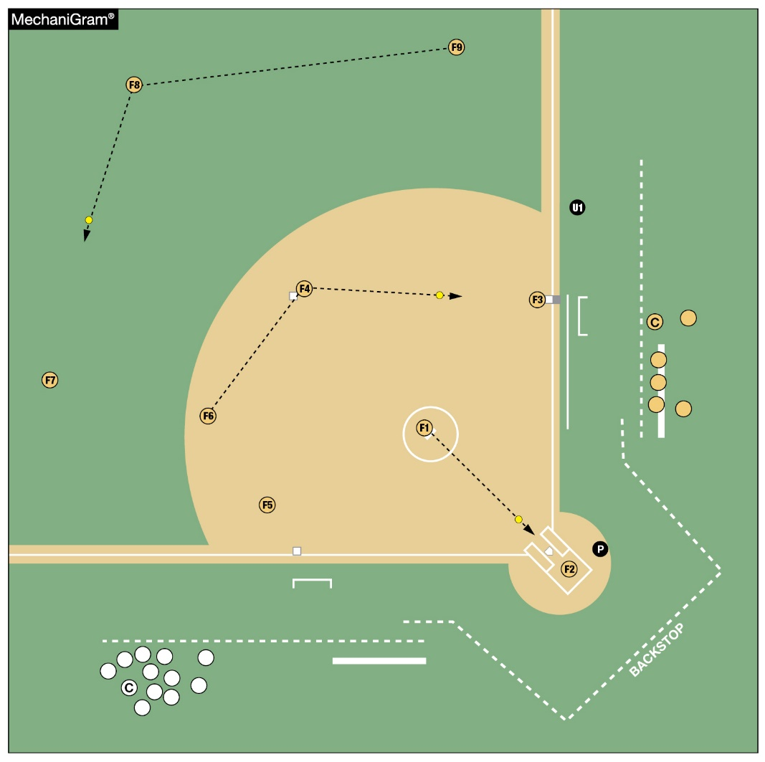
HUDDLES BETWEEN INNINGS
Teams choosing to huddle:
Should be in a safe location when the other team is warming up on the field
Does not impede the warm- up of the defensive team
Does not place them in areas where overthrows are likely
Notes:
HUDDLES BETWEEN INNINGS
If a team chooses to huddle on the field after a third out while the other team is warming up, care should be taken to ensure they do so in a safe location. In between innings as the defensive team takes the field and begins to throw the ball, the offensive team should only huddle in an area that does not impede the warm-up of the defensive team nor places them in areas where overthrows are likely. Huddling should be limited to the amount of time needed for the defensive players to make their warm-up throws, during the one minute permitted by rule. Huddling in appropriate areas will assist with minimizing risk to participants.

Slide 28
HUDDLES BETWEEN INNINGS
This play pic shows the teams huddling behind the dugout fence
That is not current practice
Notes:
HUDDLES BETWEEN INNINGS
If a team chooses to huddle on the field after a third out while the other team is warming up, care should be taken to ensure they do so in a safe location. In between innings as the defensive team takes the field and begins to throw the ball, the offensive team should only huddle in an area that does not impede the warm-up of the defensive team nor places them in areas where overthrows are likely. Huddling should be limited to the amount of time needed for the defensive players to make their warm-up throws, during the one minute permitted by rule. Huddling in appropriate areas will assist with minimizing risk to participants.

Slide 29
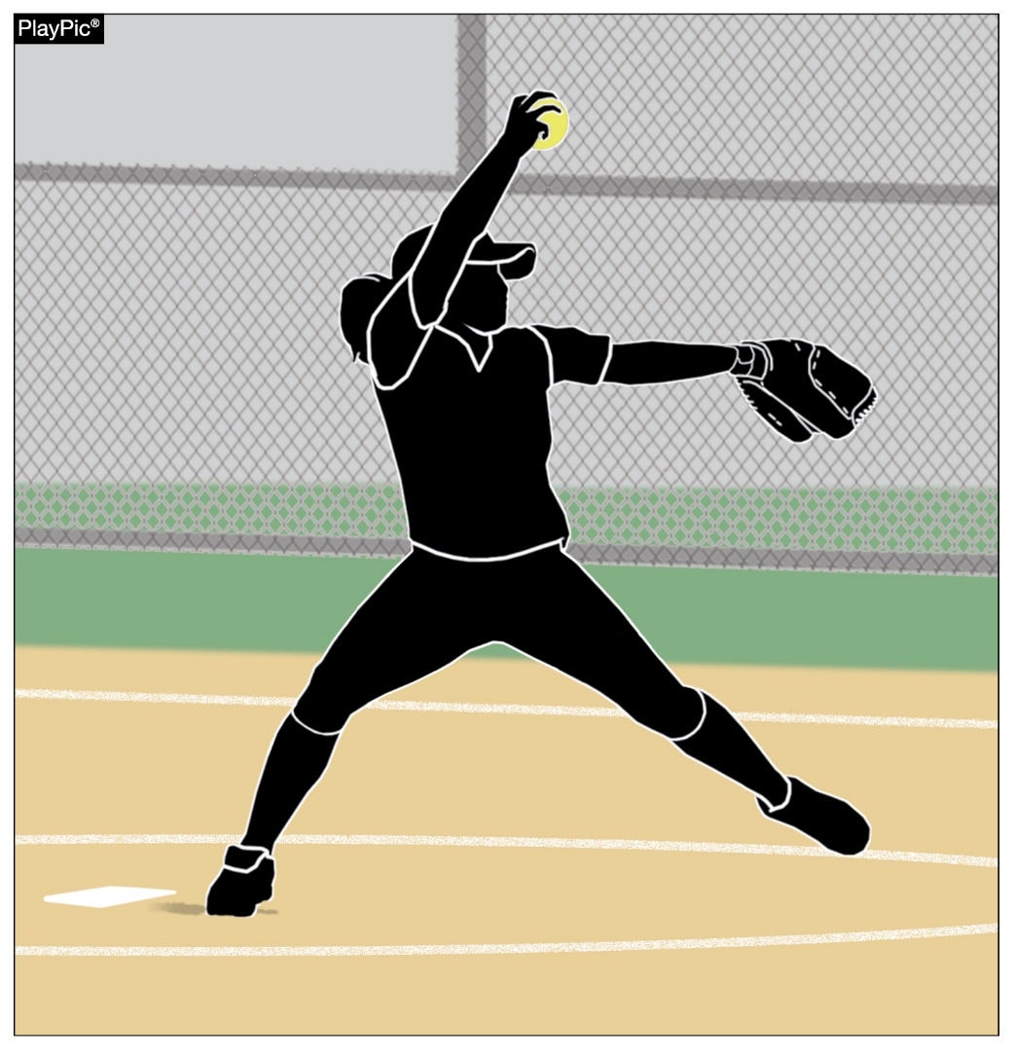
GUIDANCE FOR PITCHER UTILIZATION
Ongoing concern regarding overuse injuries of the shoulder and elbow of softball pitchers at the high school level;
Available injury data do not warrant the implementation of pitch or inning limitations;
Committees will continue to monitor all available research.
Notes:
GUIDANCE FOR PITCHER UTILIZATION
The past several years have seen an increasing concern regarding overuse injuries of the shoulder and elbow among softball pitchers at the high school level. The NFHS Sports Medicine Advisory Committee (SMAC) and the NFHS Softball Rules Committee continue to monitor injury rates of high school softball players through the National High School Sports-Related Injury Surveillance Study [High School Reporting Online (RIO)], which is an annual collection of injuries experienced while participating in high school sports. The injury data are presented to the NFHS Softball Rules Committee each year and reviewed when applicable to rule proposals.
At this point in time, the available injury data do not warrant the implementation of pitch or inning limitations for high school softball. Proper technical, mental, nutritional and physical training before, during and after pitching with appropriate rest and recovery time are important components in the development of a softball pitcher, from youth through high school. The development of multiple pitchers on a team will help share the pitching load as well.
The NFHS Softball Rules Committee and the NFHS SMAC will continue to monitor RIO and other available research regarding shoulder and elbow injury risk for high school softball pitchers.

Slide 30
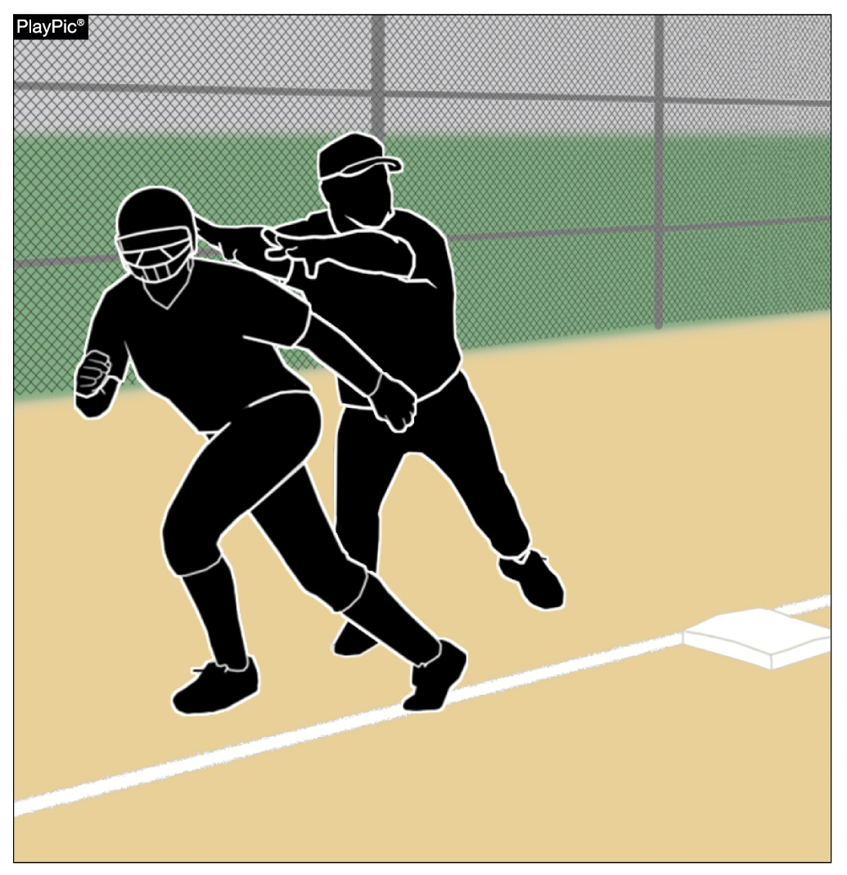
ASSISTING A RUNNER
Coaches or any other team personnel are not permitted to assist a runner during playing action.
When a home run occurs, although the ball is out of play (enters dead ball territory), runners have live ball running responsibilities and are still required to legally run the bases.
Notes:
ASSISTING A RUNNER
To score a run, the runner must legally advance to and touch first, second, third and then home plate. Coaches or any other team personnel are not permitted to assist a runner in any manner during playing action. When a home run occurs, although the ball is out of play (enters dead-ball territory), runners have live-ball running responsibilities and are still required to legally run the bases. If someone other than another runner physically assists a runner, the assisted runner is ruled out. Similarly, if the runner passes another runner they would be ruled out. Lastly, if the runner misses a base and it is properly appealed, the runner would also be ruled out.

Slide 31
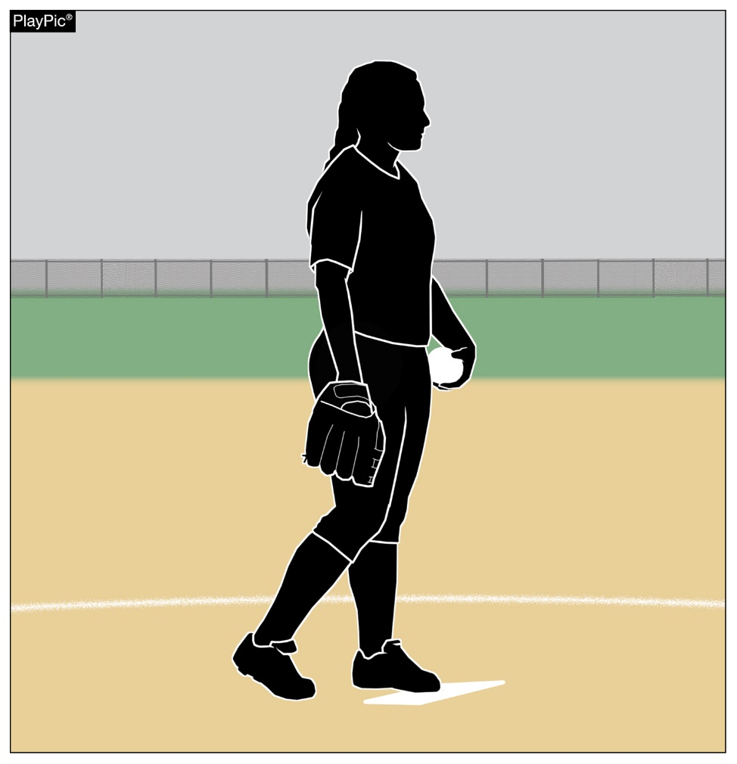
PITCHER SIMULATING TAKING A SIGN
While the pivot foot is in contact with the pitcher’s plate and prior to bringing the hands together, the pitcher must take or simulate taking a signal from the catcher.
A signal may be taken from a coach either by hand signal, verbal call, or by looking up on a wristband with a playbook/playcard.
If the pitcher does not pause after stepping onto the pitcher’s plate, an illegal pitch should be called.
Notes:
PITCHER SIMULATING TAKING A SIGN
While the pivot foot is in contact with the pitcher’s plate and prior to bringing the hands together the pitcher must take or simulate taking a signal from the catcher. A signal may be taken from a coach either by hand signal, verbal call, or by looking up on a wristband with a playbook/playcard. This signal can be taken while in contact with the pitcher’s plate or while standing behind the pitcher’s plate prior to taking a position in contact with the pitcher’s plate. None of these actions are illegal by rule; the only requirement is that no matter where or from whom the actual signal is obtained, the pitcher must take a position with the pivot foot in contact with the pitcher’s plate with the hands separated and simulate taking a signal from the catcher prior to bring their hands together, an illegal pitch should be called.

Slide 32
PITCHER SIMULATING TAKING A SIGN
As officials we need to do our job to ensure the pitchers are not quick pitching to the batters.
Quick pitching throws the batter off and gives the defense an unfair advantage.
Notes:
PITCHER SIMULATING TAKING A SIGN
While the pivot foot is in contact with the pitcher’s plate and prior to bringing the hands together the pitcher must take or simulate taking a signal from the catcher. A signal may be taken from a coach either by hand signal, verbal call, or by looking up on a wristband with a playbook/playcard. This signal can be taken while in contact with the pitcher’s plate or while standing behind the pitcher’s plate prior to taking a position in contact with the pitcher’s plate. None of these actions are illegal by rule; the only requirement is that no matter where or from whom the actual signal is obtained, the pitcher must take a position with the pivot foot in contact with the pitcher’s plate with the hands separated and simulate taking a signal from the catcher prior to bring their hands together, an illegal pitch should be called.

Slide 33
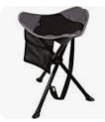
BUCKETS/STOOLS
Buckets/Stools are to remain in the dugout. They will not be allowed on the field during live play.
Coaches are to remain in the dugout unless they are coaching a base or making a defensive call. After the defensive call has been made, they are to be back in the dugout. No Loitering outside the dugout.

Slide 34
Questions

