Slide 1
Tyler Chapter New Umpire Training
December 12, 2021

Slide 2
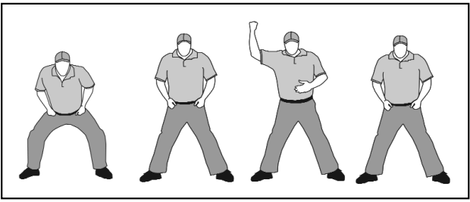
Routine Out

Slide 3
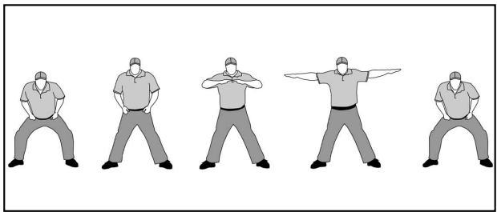
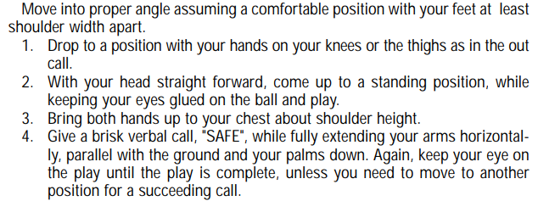
Routine Safe

Slide 4
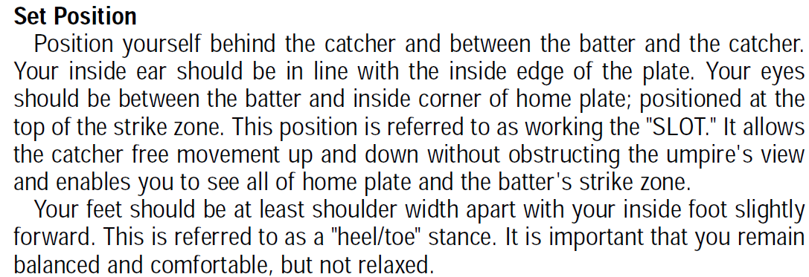
Plate Mechanics- Set Position

Slide 5
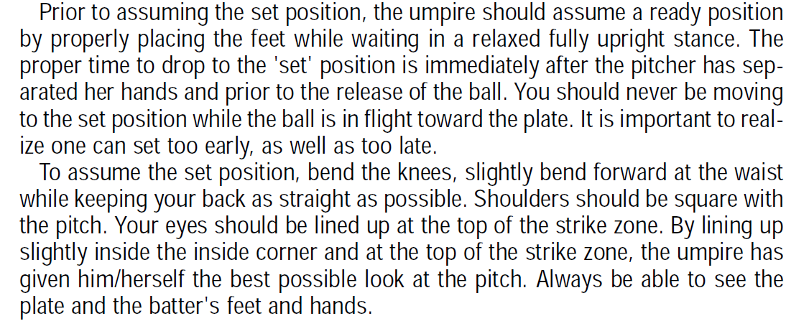
Plate Mechanics- Set Position

Slide 6
Plate Mechanics- Set Position

Slide 7
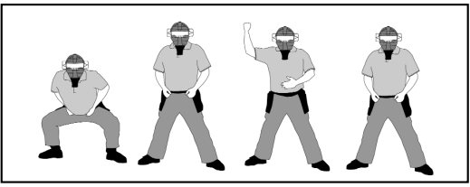
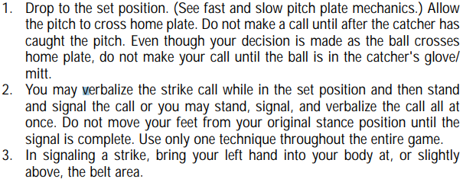
Calling Strikes

Slide 8
Calling A Ball

Slide 9
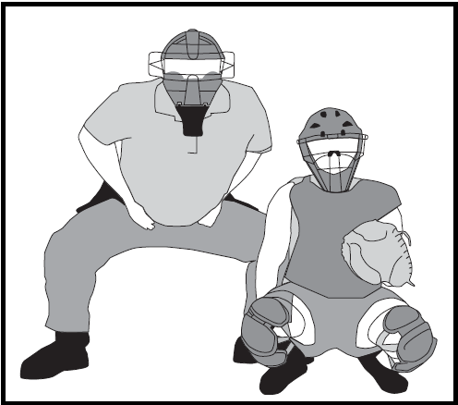
Working the LEFT Slot

Slide 10
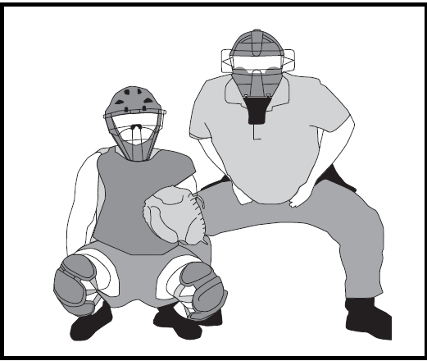
Working the RIGHT Slot

Slide 11
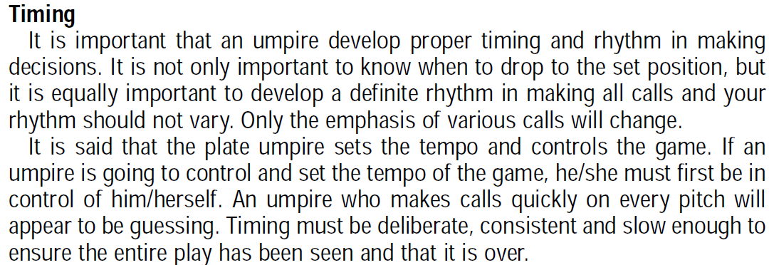
Plate Mechanics- Timing

Slide 12
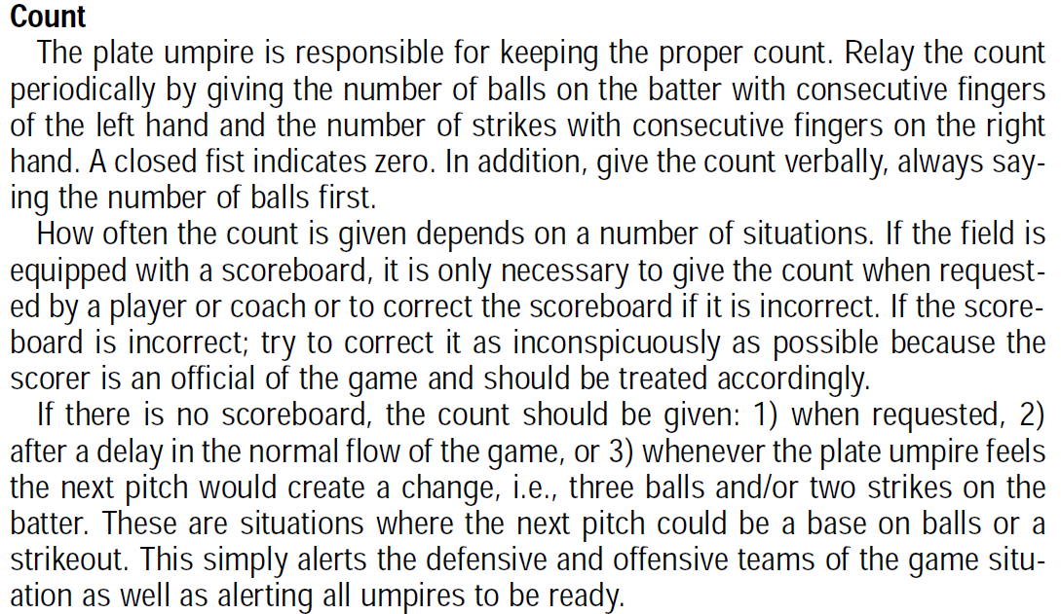
Plate Mechanics- Count

Slide 13
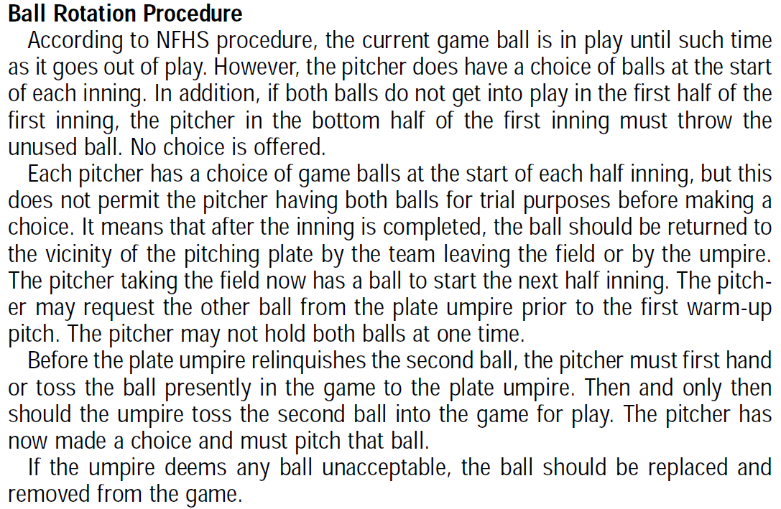
Plate Mechanics- Ball Rotation Procedure

Slide 14
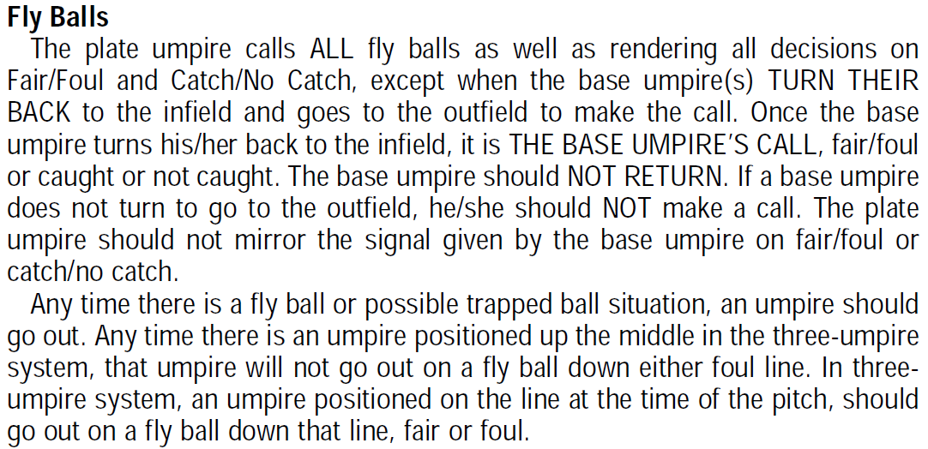
Plate Mechanics- Fly Balls

Slide 15
Plate Mechanics- Fly Balls

Slide 16
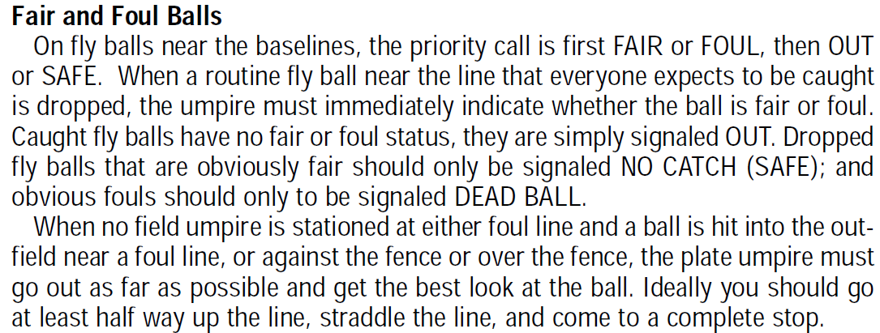
Plate Mechanics- Fair and Foul Balls

Slide 17
Plate Mechanics- Fair and Foul Balls

Slide 18
Base Mechanics – Inside Out Theory

Slide 19
Base Mechanics – Buttonhook

Slide 20
Base Mechanics – Buttonhook

Slide 21
Base Mechanics – Running Out of the Baseline

Slide 22
Base Mechanics – Interference

Slide 23
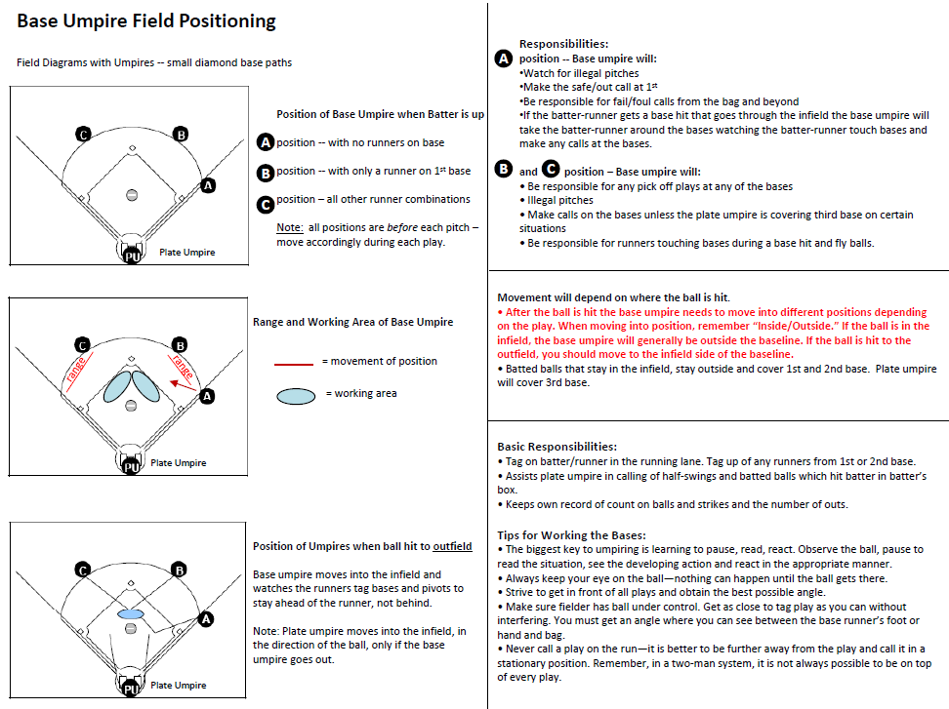

Slide 24
Section 4 Equipment And Apparel
Article 1- Umpires working the plate in fast pitch shall wear a throat protector that is part of or attached to the mask and extends far enough to adequately protect the throat. A chest protector is recommended in fast pitch.
Article 2 The proper uniform for an umpire consists of :
Powder Blue/Navy Blue Shirt White/Blue or Black Undershirt Black Belt 1-1/2”
Heather Gray Slacks TASO Hat Predominantly Black Shoes
Blue or Black Calf Length Socks College Softball Jacket
Article 3- Casts, sprints and braces may be worn, if padded.

Slide 26
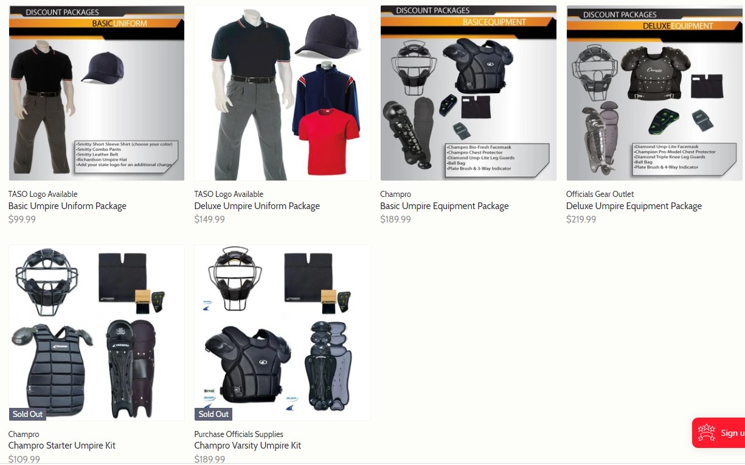
https://officialsgearoutlet.com/collections/umpire-shirts

