Slide 1
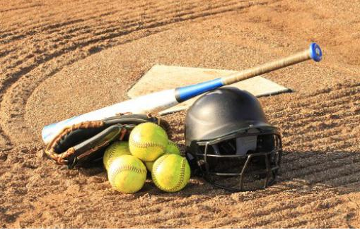
TYLER SOFTBALL CHAPTER Training
February 10, 2019

Slide 2
Outline
Review of POE and Rules Changes (Questions)
Officials Code of Ethics
Umpire Basics Rule 10
Plate Meeting
Communications Co-Officials and Coaches
How to find information in the Rule and Case Books
Dead Ball Tables

Slide 3
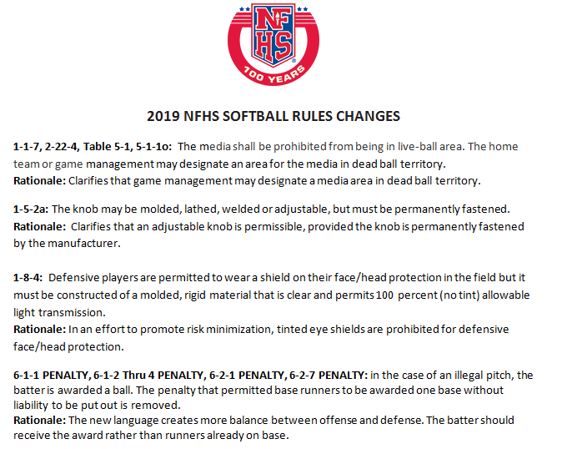
Notes:
Media Placement
Knob of Bat
Face Shield
Illegal Pitch Penalty

Slide 4
Notes:
Appeal on an intentional walk
Pitcher step back prior to or in conjunction with hands separating
DP/Flex

Slide 5
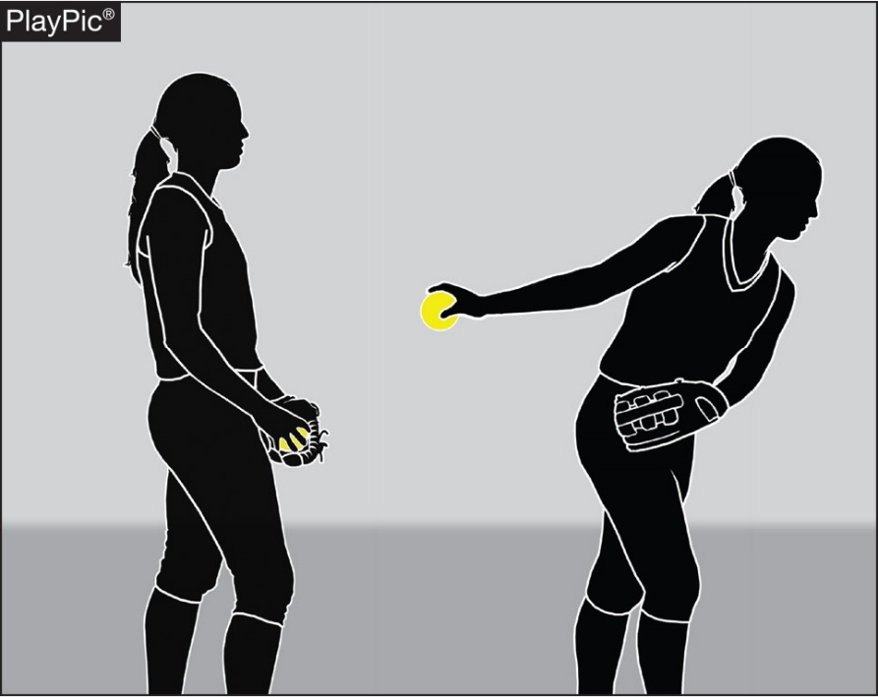
Pitching 6-1-2a, 6-1-2b
Clarifies that the pitch starts when the pitcher’s hands are separated after they have come together while the pivot foot is on or partially on top of the pitcher’s plate. Any step back with the non-pivot foot must begin before the start of the pitch.
Notes:
START OF THE PITCH RULES 6-1-2a, 6-1-2b
Clarifies that the pitch starts when the pitcher’s hands are separated after they have come together while the pivot foot is on or partially on top of the pitcher’s plate. Any step back with the non-pivot foot must begin before the start of the pitch.
This editorial change defines what motion constitutes the start of the pitch and when the step back of the non-pivot foot may be taken. The pitch starts when the hands separate, whether or not the pitcher uses a windup. Any step back with the non-pivot foot must begin before the start of the pitch. Once the pitch has started (the hands separate), the pitcher shall not take more than one step which must be forward, toward the batter and simultaneous with the delivery.

Slide 6
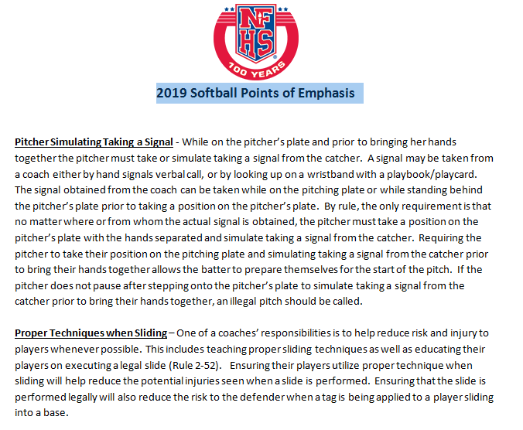
Notes:
Taking a signal or simulated (Causing a pause) not allowing a walk through pitching motion
Proper sliding technique

Slide 7
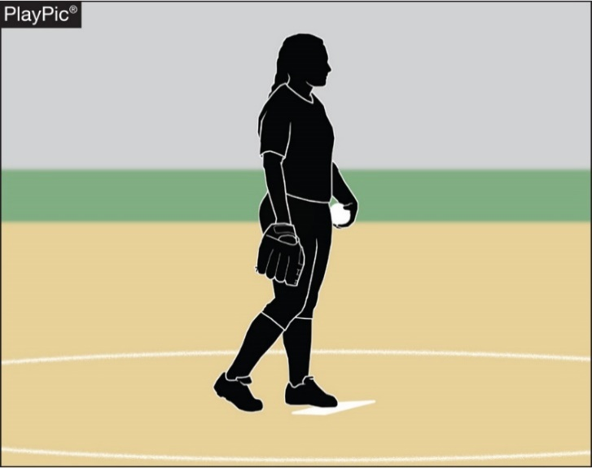
Simulate taking a sign A 2019 Point of EMPHASIS!
If the pitcher does not pause
after stepping onto the
pitcher’s plate to simulate
taking a signal prior to
bringing her hands together,
an illegal pitch should be
called.
Notes:
SIMULATE TAKING A SIGN
if the pitcher does not pause after stepping onto the pitcher’s plate to simulate taking a signal prior to bringing her hands together, an illegal pitch should be called.
While on the pitcher’s plate and prior to bringing her hands together the pitcher must take or simulate taking a signal from the catcher. A signal may be taken from a coach either by hand signals verbal call, or by looking up on a wristband with a playbook/playcard. A signal may be taken from a coach either by hand signals verbal call, or by looking up on the playbook/playcard.

Slide 8
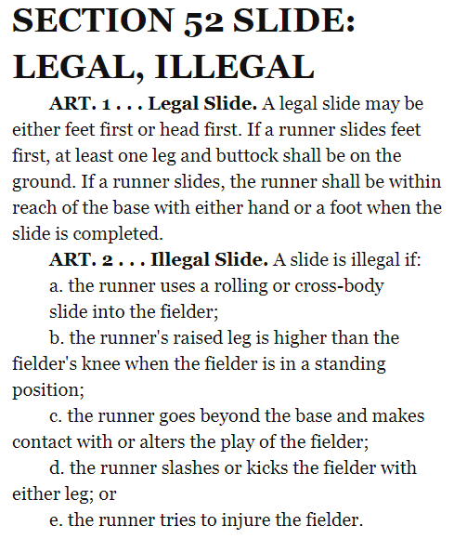
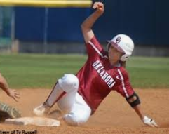
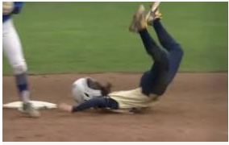
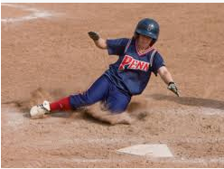
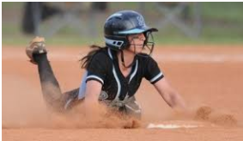
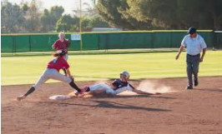

Slide 9
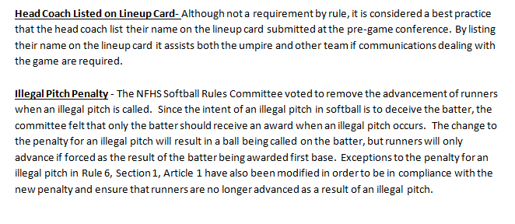
Notes:
Head Coach on Line Up card
Illegal Pitch Penalty

Slide 10
ILLEGAL PITCH (IP)
Umpire signals delayed-dead ball, and
Verbalizes illegal pitch (loud enough for the nearest players to hear)
Ball NOT hit and no base runners
Ball hit AND/OR there are base runners
Ball awarded to batter
Ball 4 IP OR
Batter hit by IP
Batter reaches 1B AND
Other runners advance at least 1 base
Batter does not reach 1B OR
Other runners fail to advance at least 1 base
Batter awarded 1B
Other runners advance only if forced
Note:
Interference does not negate IP
IP nullified
Coach has option of result of play or IP penalty
Notes:
Flow chart

Slide 11
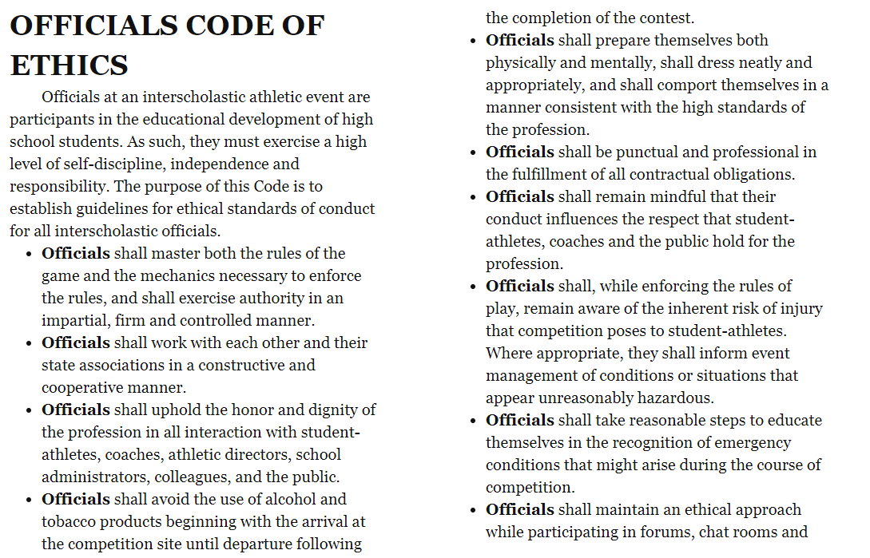
Notes:
Umpire Ethics according to NFHS

Slide 12
Rule 10 Umpire Basics
Sections:
General
Plate Umpire
Field Umpire
Equipment and Apparel

Slide 13
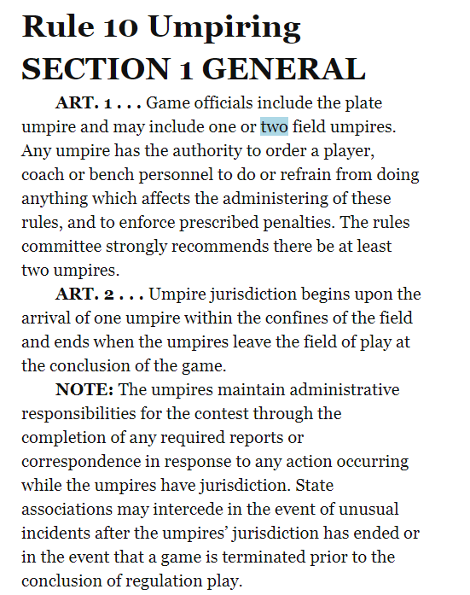

Slide 14
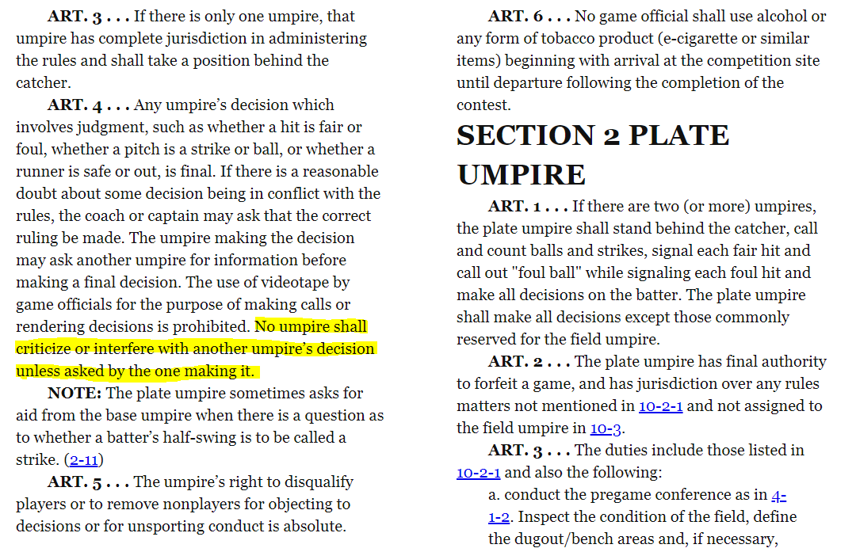

Slide 15
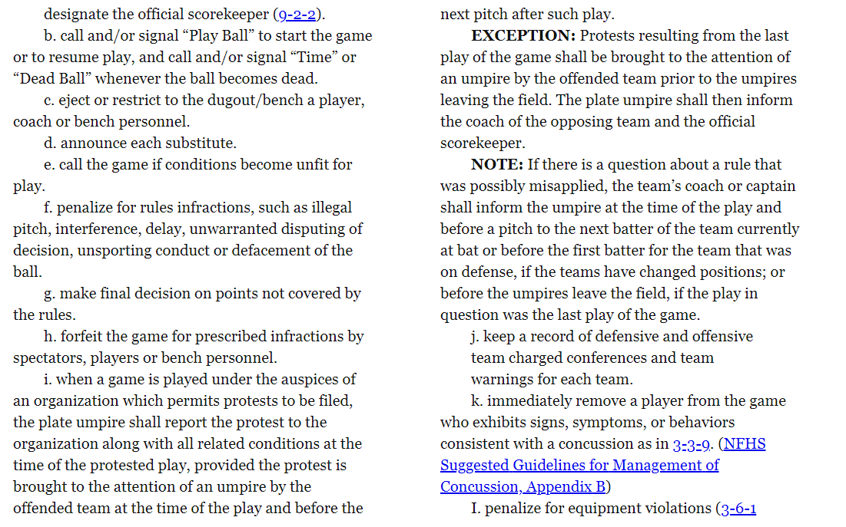

Slide 16
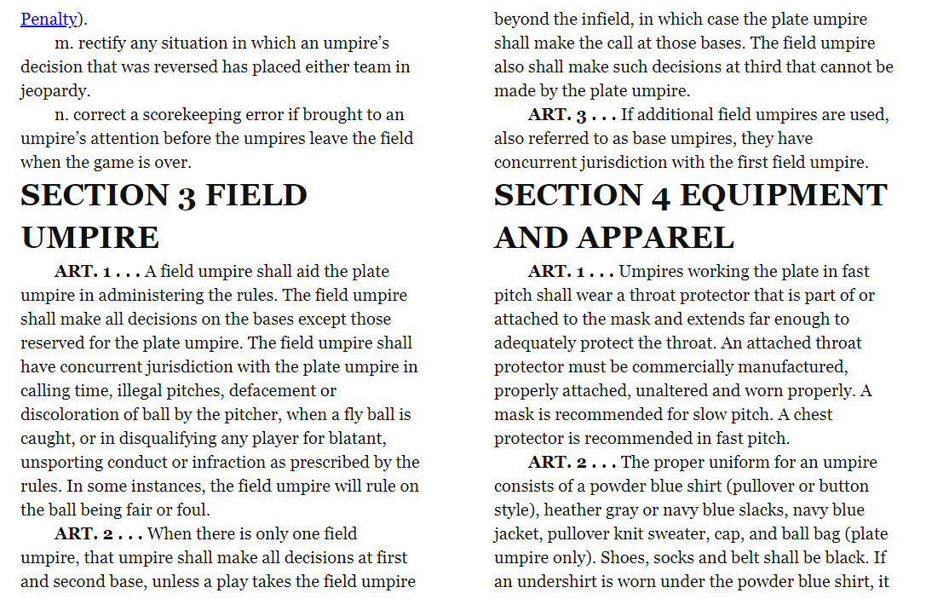

Slide 17
Section 4 Equipment And Apparel
Article 1- Umpires working the plate in fast pitch shall wear a throat protector that is part of or attached to the mask and extends far enough to adequately protect the throat. A chest protector is recommended in fast pitch.
Article 2 The proper uniform for an umpire consists of :
Powder Blue/Navy Blue Shirt White/Blue or Black Undershirt Black Belt 1-1/2”
Heather Gray Slacks TASO Hat Predominantly Black Shoes
Blue or Black Calf Length Socks College Softball Jacket
Article 3- Casts, sprints and braces may be worn, if padded.

Slide 18
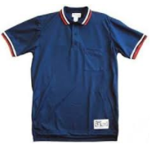
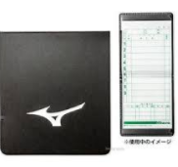
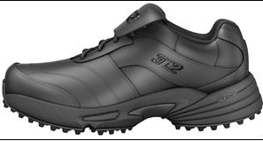
UNIFORM & GEAR

Slide 19
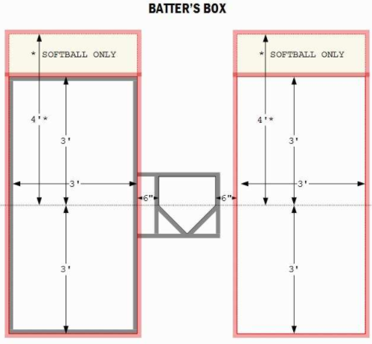
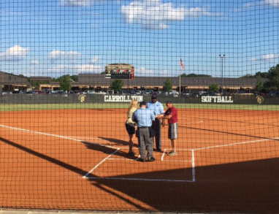
The
Pregame
Conference

Slide 20
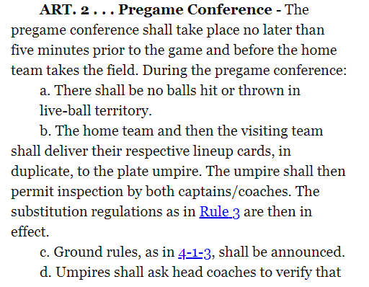
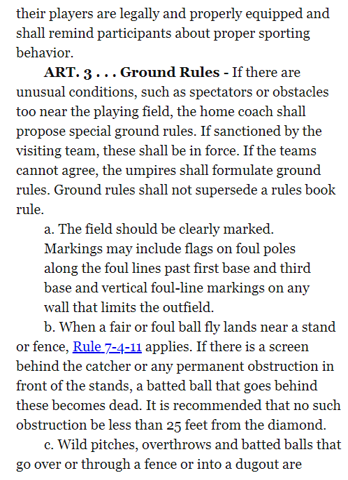
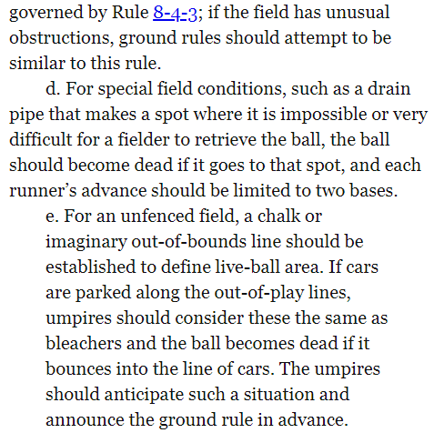

Slide 21
What I keep in my Ball Bags that gives me the confidence that I can handle anything the game is going to throw at me.
Lineup Card Holder w/clips to secure the lineups in place. Also has notes in and on it for the pre-game meeting and other items.
Some type of writing instrument to record the changes to the lineups as well the number of conferences both on offense and defense. Pen(s) Red, Blue, and Black
DP/FLEX Card- Cheat Sheet
An extra indicator
An extra brush
Copy of the Non-Approved Bat List just in case

Slide 22
COMMUNICATIONS
Partner
Pre-Game:
Where and When to meet
What color shirt to wear
During:
As needed to effectively adjudicate
the contest
After:
As needed if something needs to be
communicated to BOD Members and
TASO.
Coach
Pre-Game:
Senior umpire communicate to home
coach what time you and your partner
will be onsite for their contest
During:
As needed to answer questions and
adjudicate the contest within the rules
Remember the “Officials” Golden Rule on
Communications. Silence cannot be miss-quoted

Slide 23
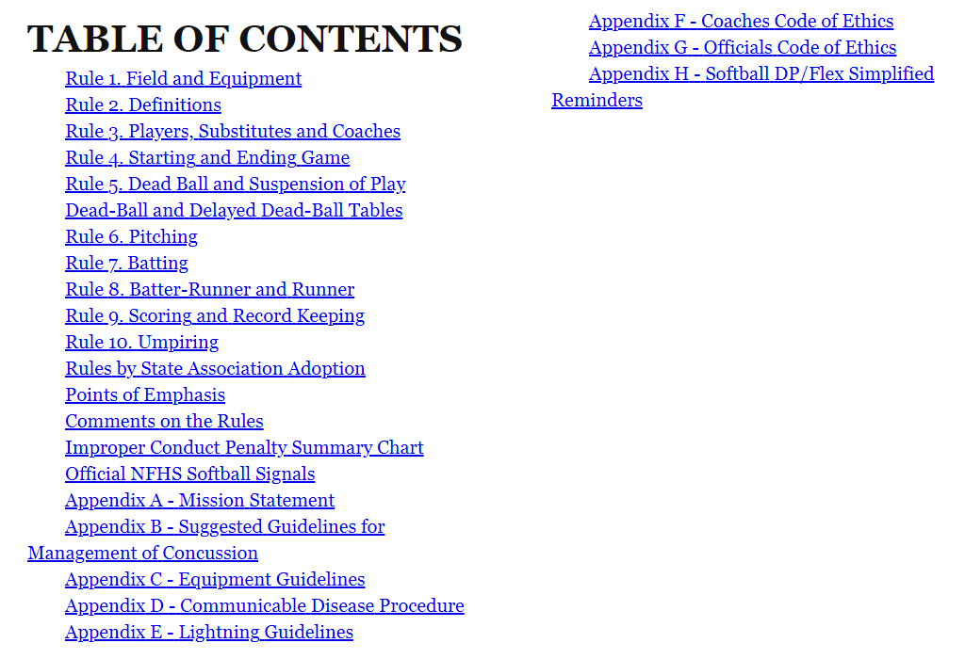

Slide 24
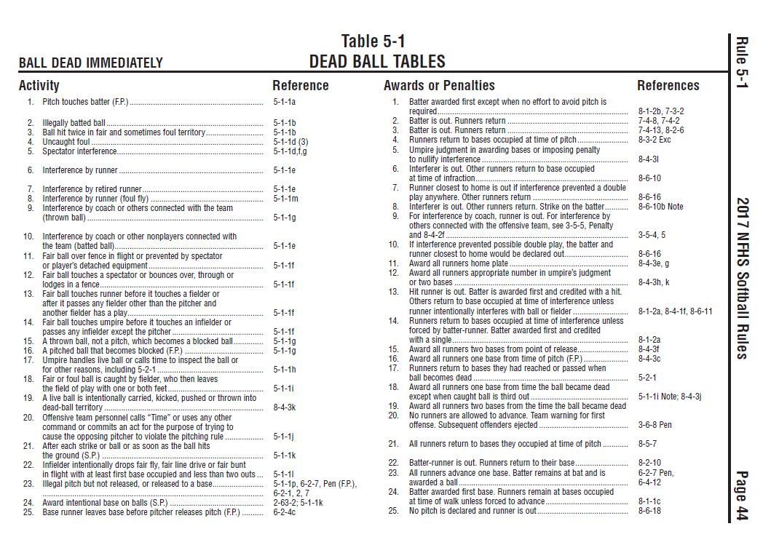
Dead Ball Tables
Rule 6 went onto clarify as to when the pitch starts and

Slide 25
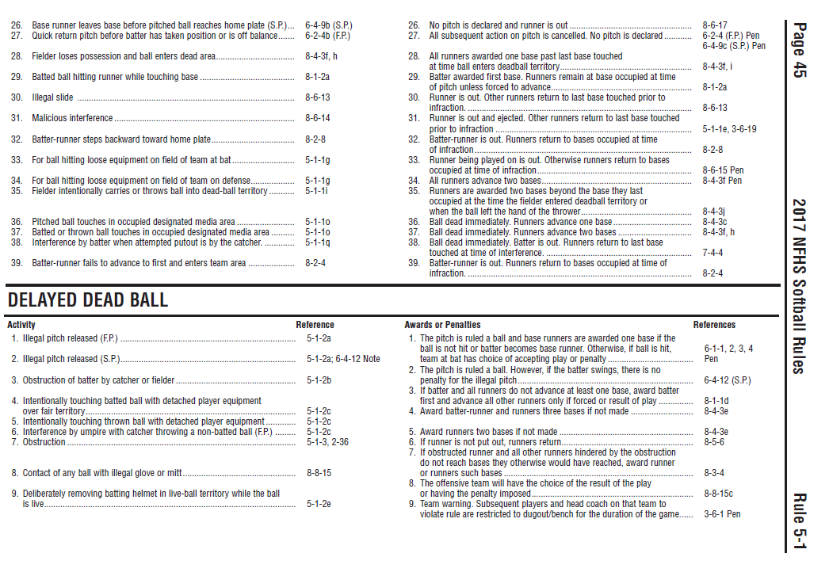
Dead Ball Tables

Slide 26
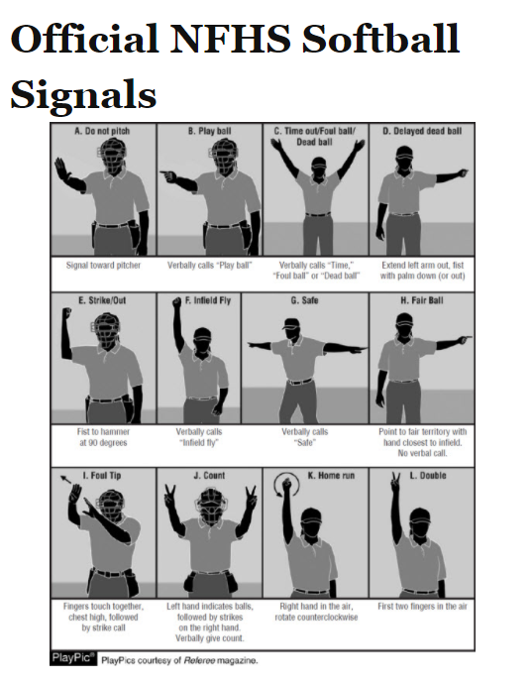

Slide 27
Scrimmages

Slide 28
Questions
?

