Slide 1
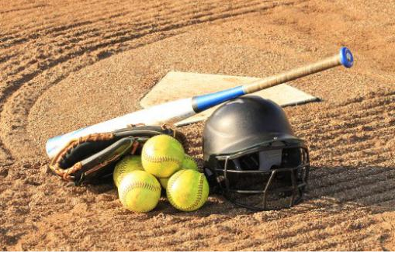
TYLER SOFTBALL CHAPTER New Official Training
February 28, 2021

Slide 2
Outline
Pitching Rule 6
Questions

Slide 3
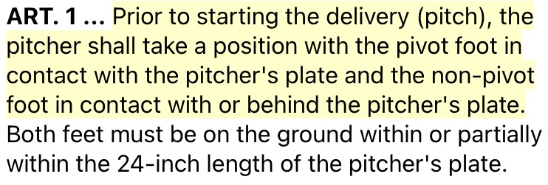
Obstruction
Pitching Rule 6-1 Article 1

Slide 4
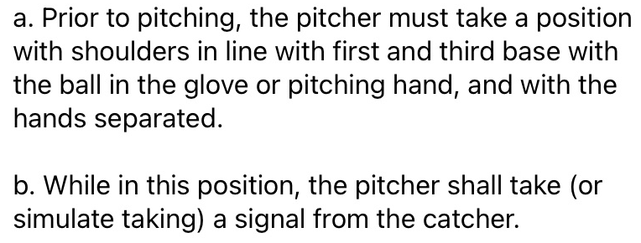
Obstruction
Pitching Rule 6-1 Article 1

Slide 5
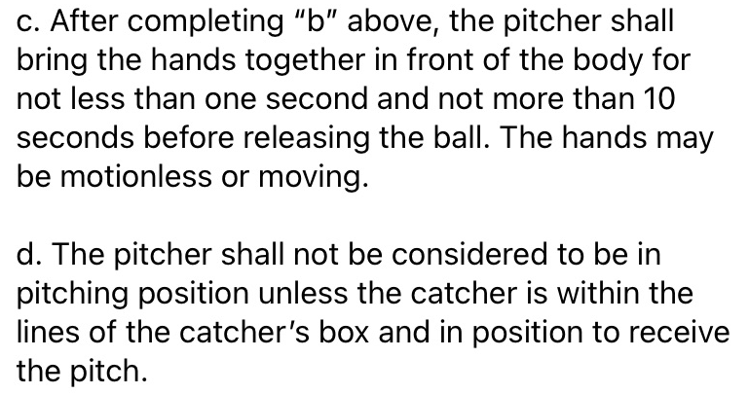
Obstruction
Pitching Rule 6-1 Article 1

Slide 6
Obstruction
Pitching Rule 6-1 Article 1

Slide 7
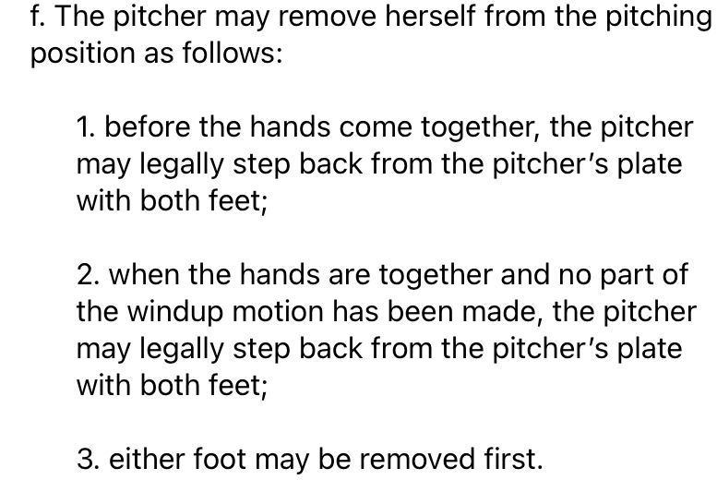
Obstruction
Pitching Rule 6-1 Article 1

Slide 8
Obstruction
Pitching Rule 6-1 Article 1

Slide 9
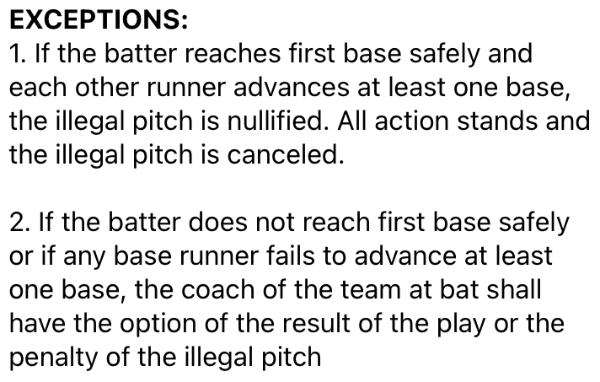
Obstruction
Pitching Rule 6-1 Article 1

Slide 10
Obstruction
Pitching Rule 6-1 Article 1

Slide 11
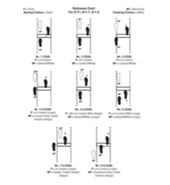
Obstruction
Pitching Rule 6-1 Article 1

Slide 12
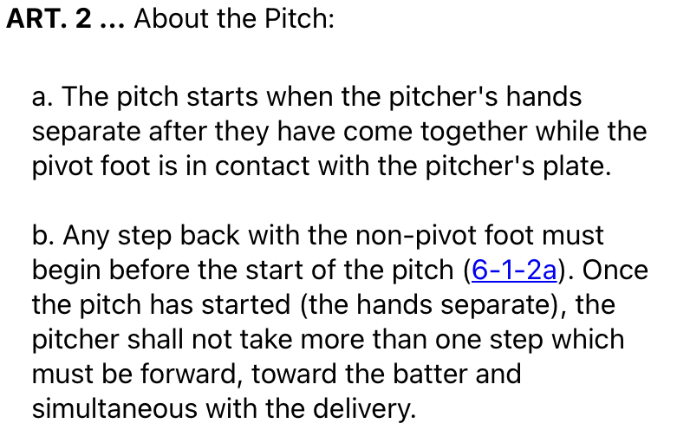
Obstruction
Pitching Rule 6-1 Article 2

Slide 13
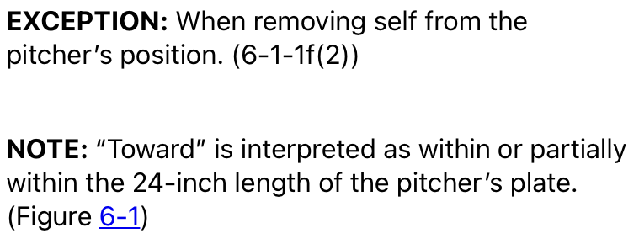
Obstruction
Pitching Rule 6-1 Article 2

Slide 14
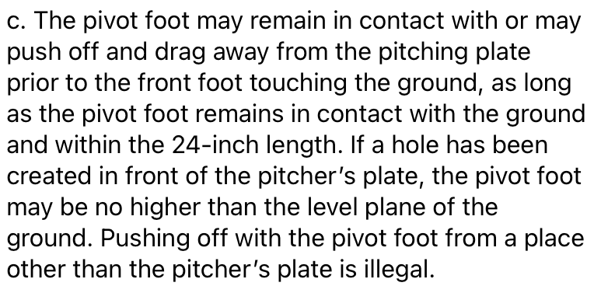
Obstruction
Pitching Rule 6-1 Article 2

Slide 15
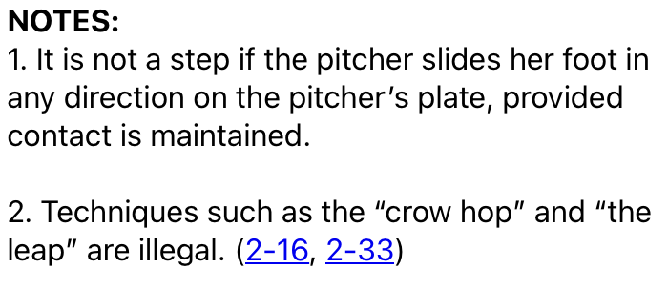
Obstruction
Pitching Rule 6-1 Article 2

Slide 16
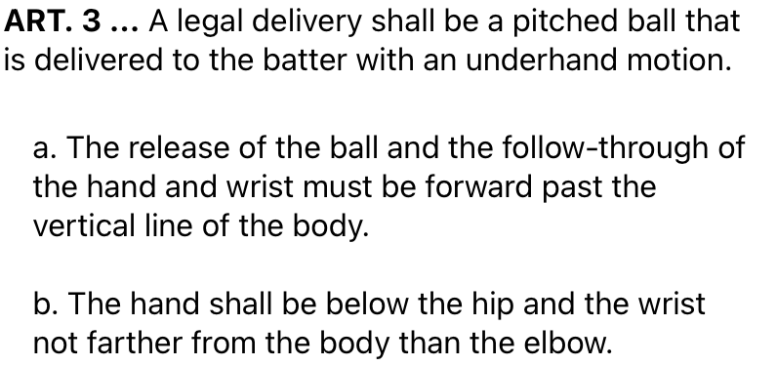
Obstruction
Pitching Rule 6-1 Article 3

Slide 17
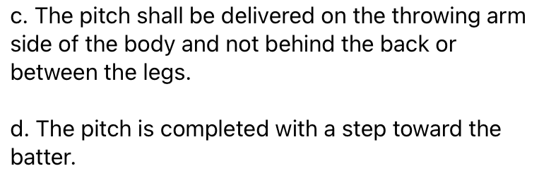
Obstruction
Pitching Rule 6-1 Article 3

Slide 18
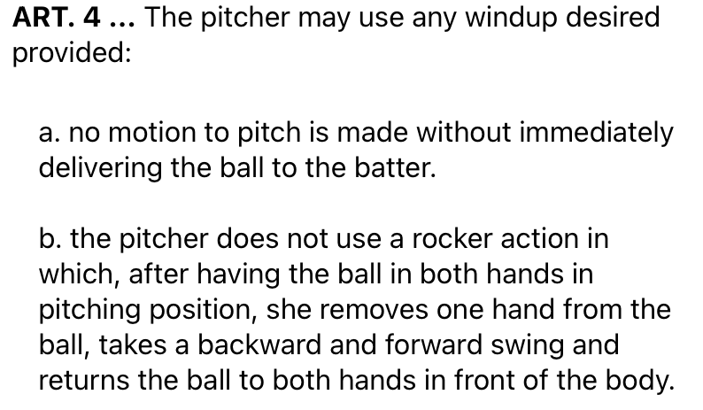
Obstruction
Pitching Rule 6-1 Article 4

Slide 19
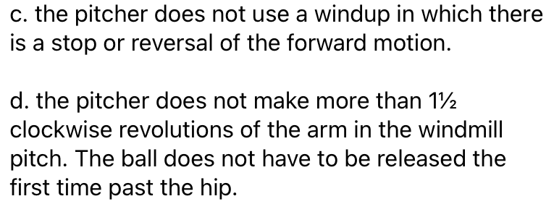
Obstruction
Pitching Rule 6-1 Article 4

Slide 20
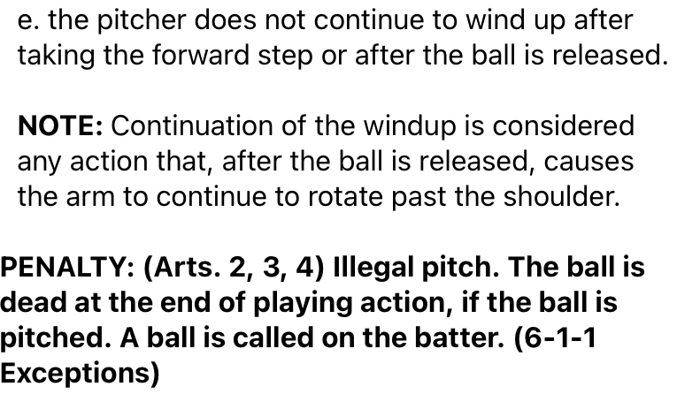
Obstruction
Pitching Rule 6-1 Article 4

Slide 21
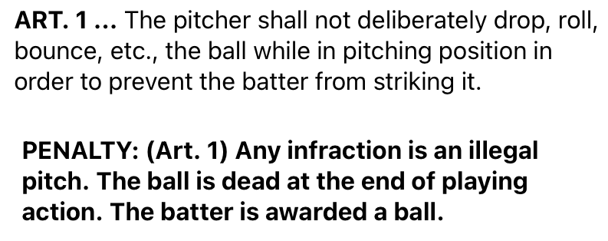
Obstruction
Pitching Rule 6-2 Article 1

Slide 22
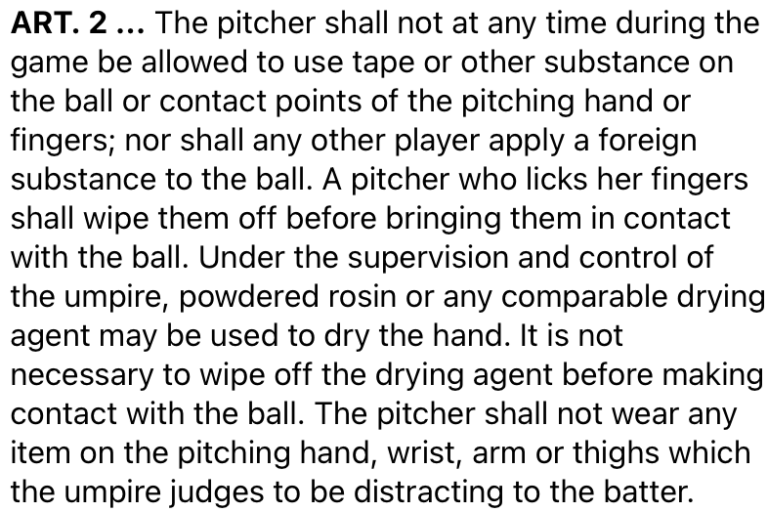
Obstruction
Pitching Rule 6-2 Article 2

Slide 23
Obstruction
Pitching Rule 6-2 Article 2

Slide 24
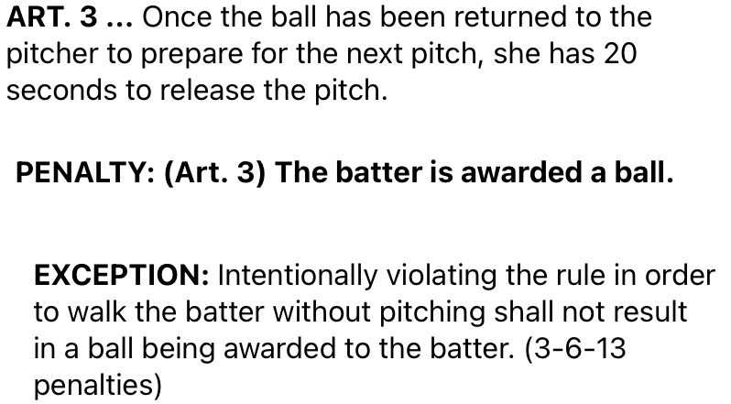
Obstruction
Pitching Rule 6-2 Article 3

Slide 25
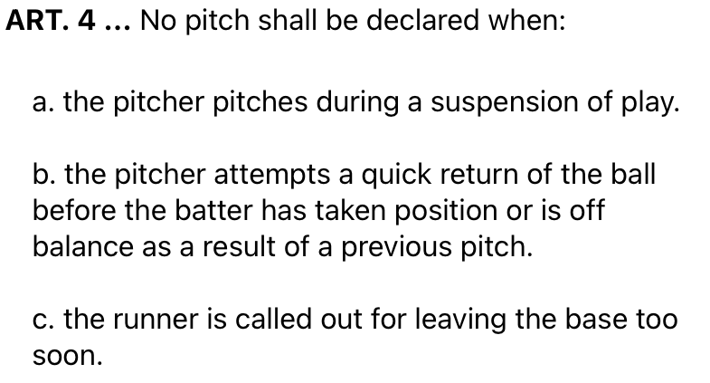
Obstruction
Pitching Rule 6-2 Article 4

Slide 26
Obstruction
Pitching Rule 6

Slide 27
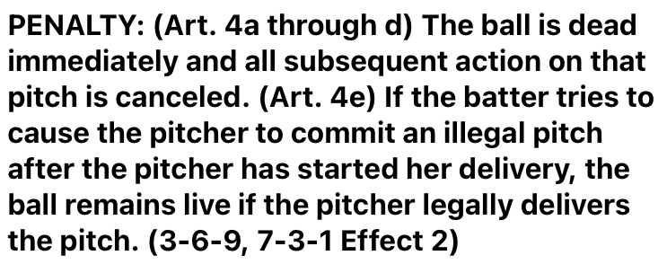
Obstruction
Pitching Rule 6

Slide 28
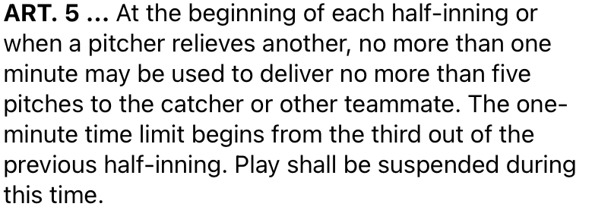
Obstruction
Pitching Rule 6-2 Article 5

Slide 29
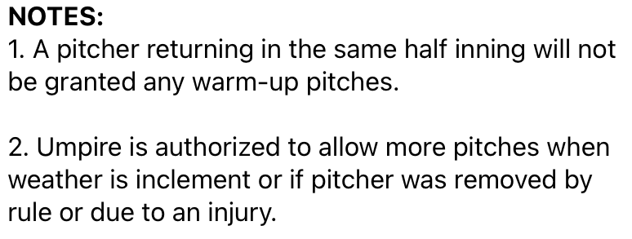
Obstruction
Pitching Rule 6-2 Article 5

Slide 30
Obstruction
Pitching Rule 6-2 Article 5

Slide 31
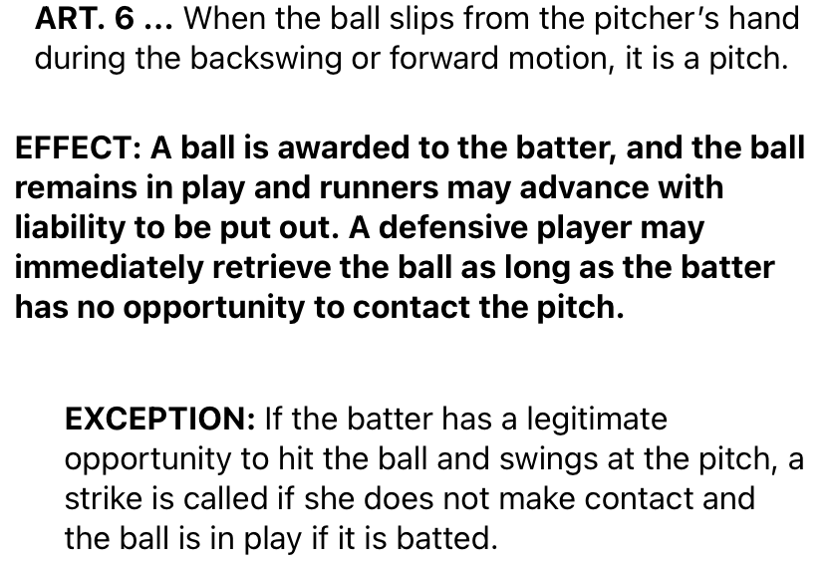
Obstruction
Pitching Rule 6-2 Article 6

Slide 32
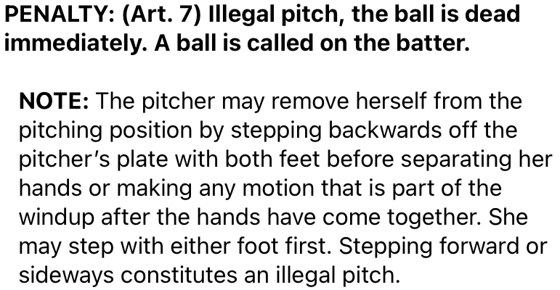
Obstruction
Pitching Rule 6-2 Article 7

Slide 33
Obstruction
Pitching Rule 6-2 Article 8 & 9

Slide 34
Obstruction
Pitching Rule 6-5 Article 1

Slide 35
Obstruction
Pitching Rule 6-5 Article 2

Slide 36
Questions

