Slide 1
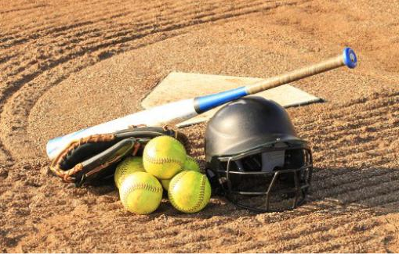
TYLER SOFTBALL CHAPTER Arbiter Training
January 10, 2021

Slide 2
Outline
Arbiter and Arbiter Pay

Slide 3
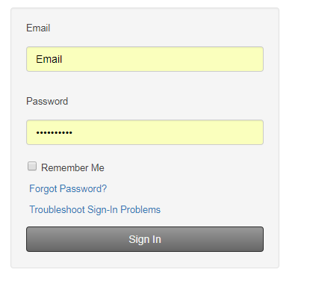
Arbiter Training How to log in

Slide 4
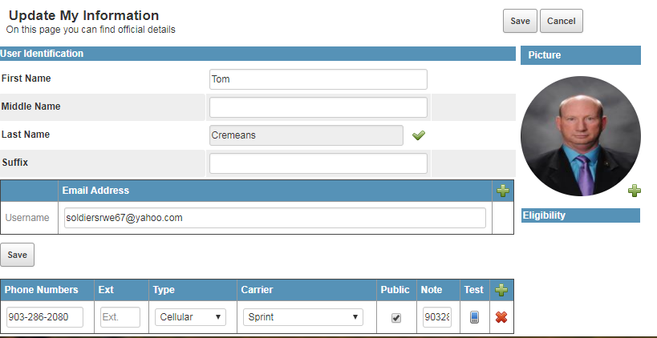
Arbiter Training How to check and update your Profile

Slide 5
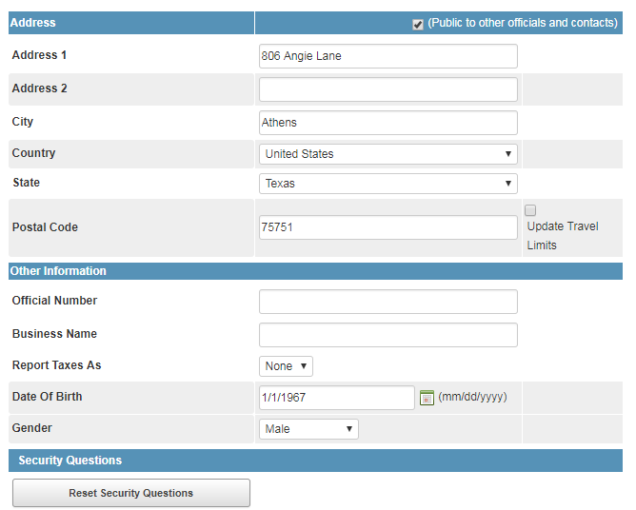
Arbiter Training How to check and update your Profile

Slide 6
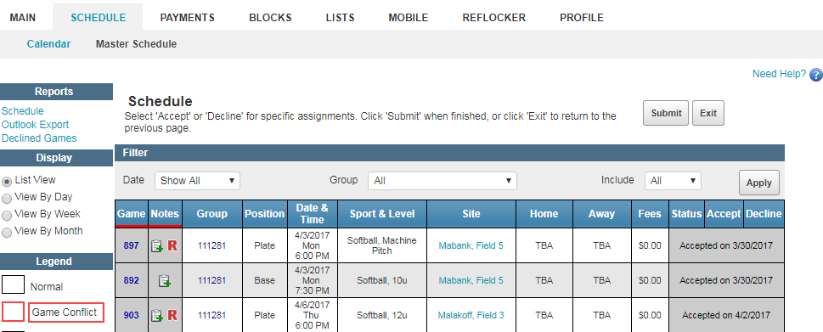
Arbiter Training How to check game assignments and partners

Slide 7
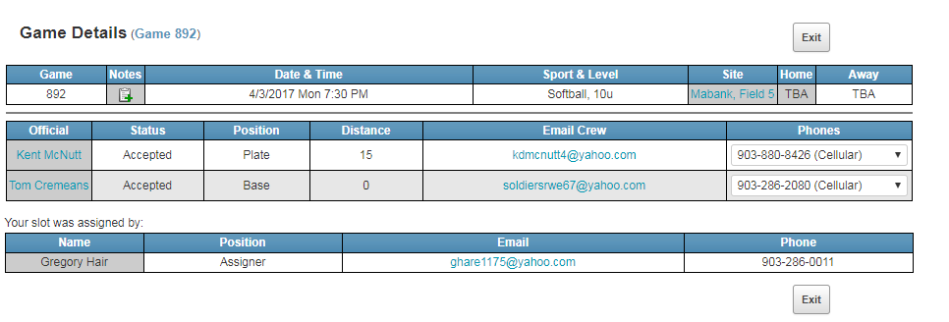
Arbiter Training How to check game assignments and partners

Slide 8
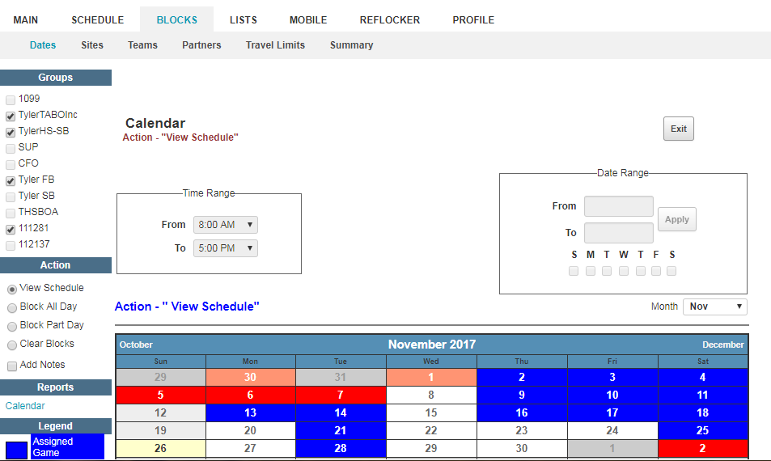
Arbiter Training How to set up blocks

Slide 9
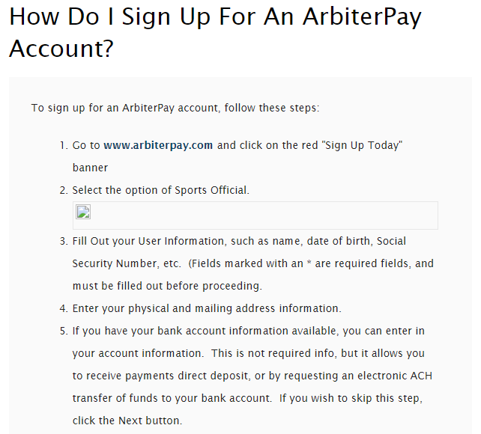
Arbiter Training How to set up an Arbiter Pay Account

Slide 10
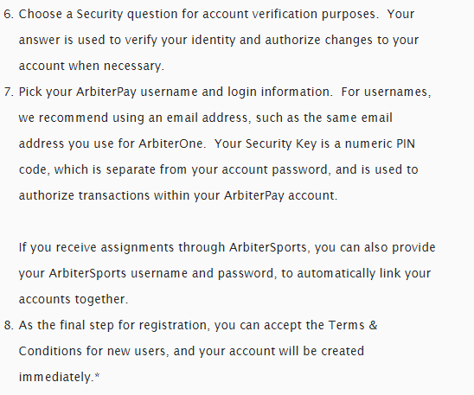
Arbiter Training How to set up an Arbiter Pay Account

Slide 11
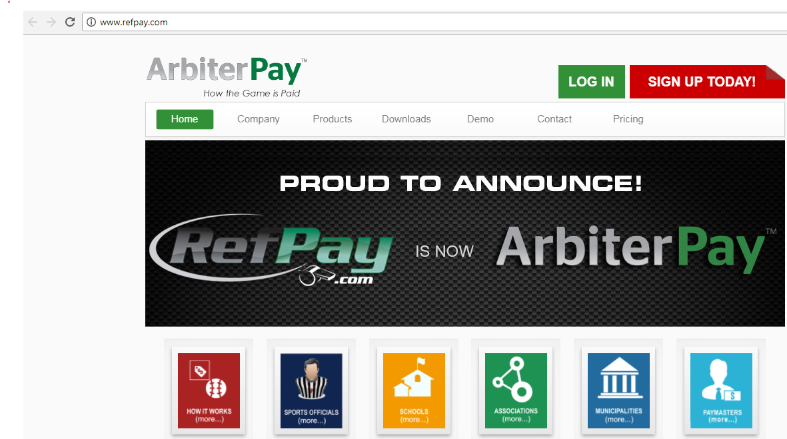
Arbiter Training How to set up an Arbiter Pay Account

Slide 12
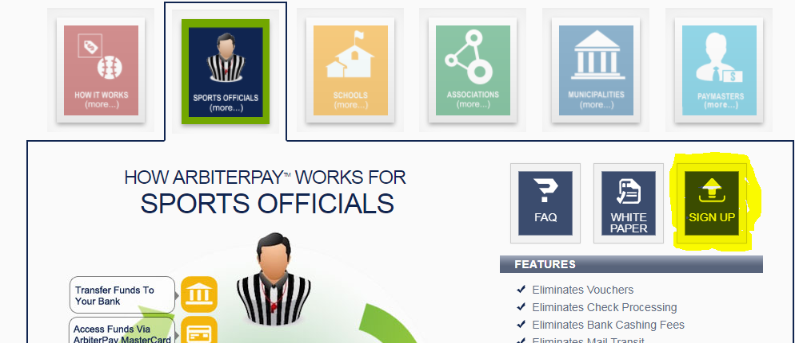
Arbiter Training How to set up an Arbiter Pay Account

Slide 13
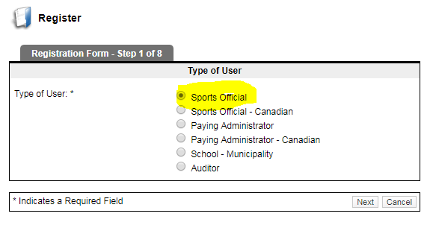
Arbiter Training How to set up an Arbiter Pay Account

Slide 14
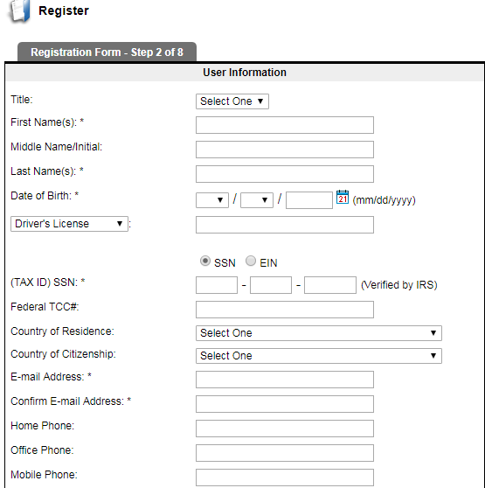
Arbiter Training How to set up an Arbiter Pay Account

Slide 15
Questions

